Slide 1
18CS46: Data Communication Module – 3 Bandwidth Utilization, Switching,
Error Detection and Correction
Poonam Kumari ASSISTANT PROFESSOR
DEPARTMENT OF INFORMATION SCIENCE AND ENGINEERING
RNS INSTITUTE OF TECHNOLOGY
CHANNASANDRA, RR NAGAR POST
Dr. VISHNUVARDHAN ROAD
BENGALURU – 560 098
poonam.rnsit@gmail.com
1

Slide 2
Chapter 6 Bandwidth Utilization:
Multiplexing and Spreading

Slide 3

Note
Bandwidth utilization is the wise use of available bandwidth to achieve specific goals.
Efficiency can be achieved by multiplexing; privacy and anti-jamming can be achieved by spreading.

Slide 4
6-1 MULTIPLEXING
Whenever the bandwidth of a medium linking two devices is greater than the bandwidth needs of the devices, the link can be shared. Multiplexing is the set of techniques that allows the simultaneous transmission of multiple signals across a single data link.. As data and telecommunications use increases, so does traffic.
Topics discussed in this section: Frequency-Division Multiplexing Wavelength-Division Multiplexing Synchronous Time-Division Multiplexing Statistical Time-Division Multiplexing

Slide 5
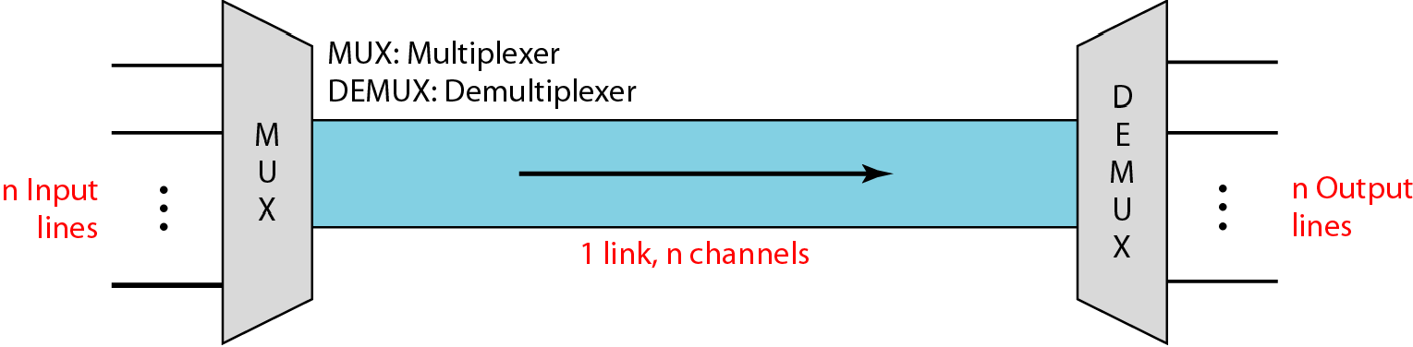
Figure 6.1 Dividing a link into channels

Slide 6
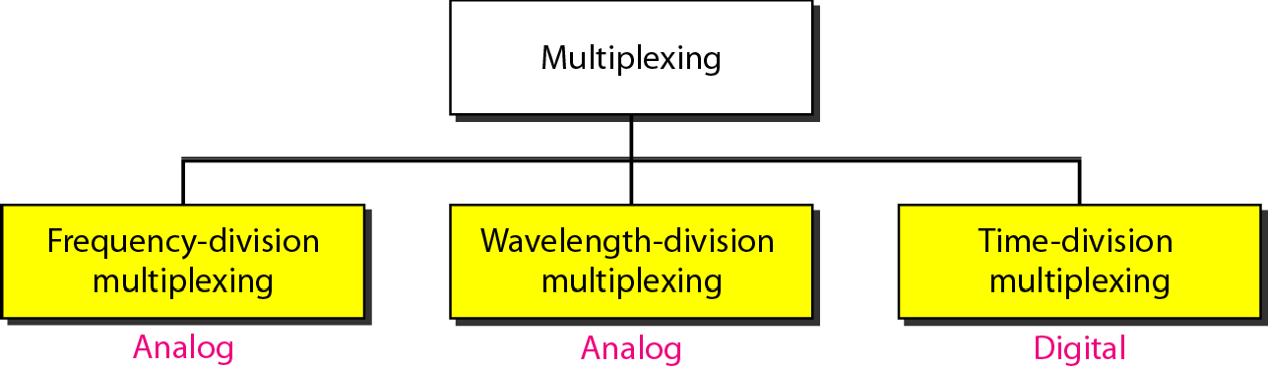
Figure 6.2 Categories of multiplexing

Slide 7
Frequency-division multiplexing
Frequency-division multiplexing (FDM) is an analog technique that can be applied when the bandwidth of a link (in hertz) is greater than the combined bandwidths of the signals to be transmitted.
In FDM, signals generated by each sending device modulate different carrier frequencies. These modulated signals are then combined into a single composite signal that can be transported by the link.
Carrier frequencies are separated by sufficient bandwidth to accommodate the modulated signal.
These bandwidth ranges are the channels through which the various signals travel.
Channels can be separated by strips of unused bandwidth—guard bands—to prevent signals from overlapping. In addition, carrier frequencies must not interfere with the original data frequencies.

Slide 8
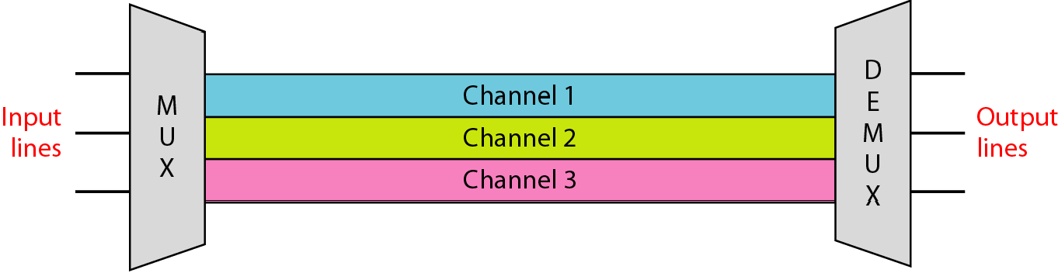
Figure 6.3 Frequency-division multiplexing

Slide 9

Note
FDM is an analog multiplexing technique that combines analog signals.

Slide 10
FDM process
Figure is a conceptual illustration of the multiplexing process.
Each source generates a signal of a similar frequency range. Inside the multiplexer, these similar signals modulate different carrier frequencies ( f1, f2, and f3).
The resulting modulated signals are then combined into a single composite signal that is sent out over a media link that has enough bandwidth to accommodate it.

Slide 11
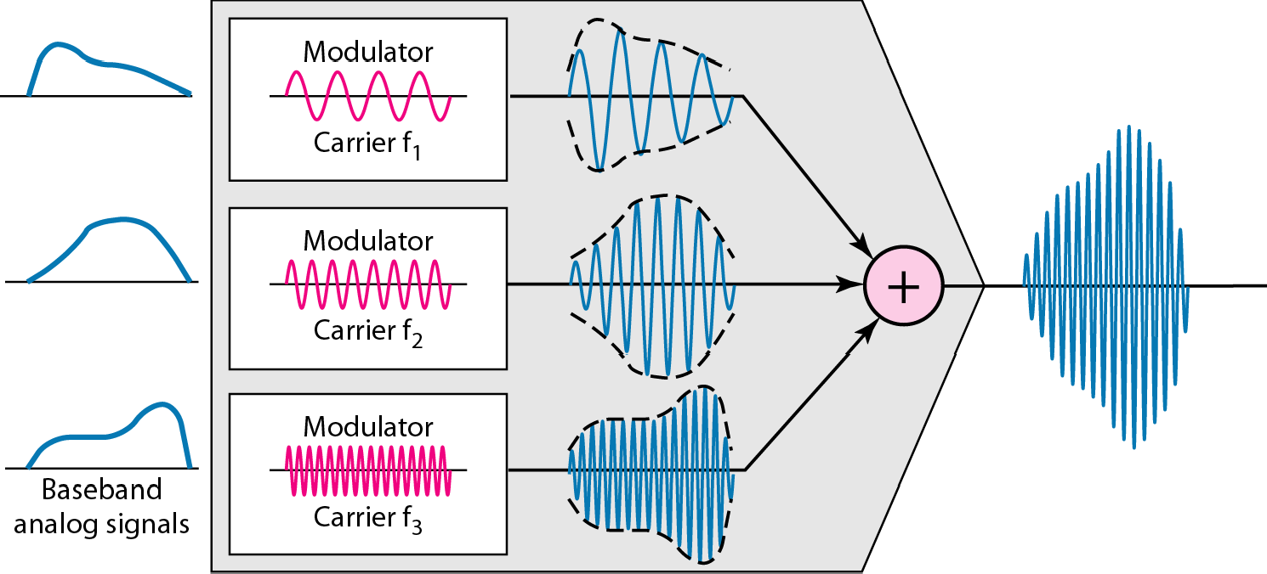
Figure 6.4 FDM process

Slide 12
FDM Demultiplexing example
The demultiplexer uses a series of filters to decompose the multiplexed signal into its constituent component signals.
The individual signals are then passed to a demodulator that separates them from their carriers and passes them to the output lines.
Figure 6.5 is a conceptual illustration of demultiplexing process.

Slide 13
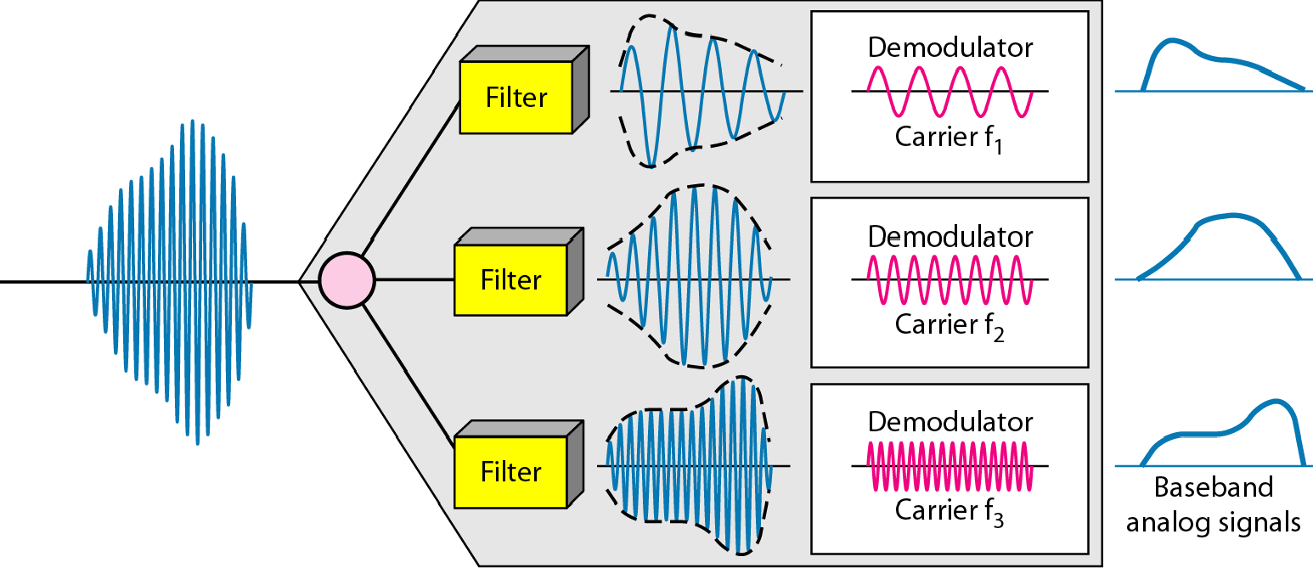
Figure 6.5 FDM demultiplexing example

Slide 14
Example 6.1
Assume that a voice channel occupies a bandwidth of 4 kHz. We need to combine three voice channels into a link with a bandwidth of 12 kHz, from 20 to 32 kHz. Show the configuration, using the frequency domain. Assume there are no guard bands.
Solution
We shift (modulate) each of the three voice channels to a different bandwidth, as shown in Figure 6.6. We use the 20- to 24-kHz bandwidth for the first channel, the 24- to 28-kHz bandwidth for the second channel, and the 28- to 32-kHz bandwidth for the third one. Then we combine them as shown in Figure 6.6.

Slide 15
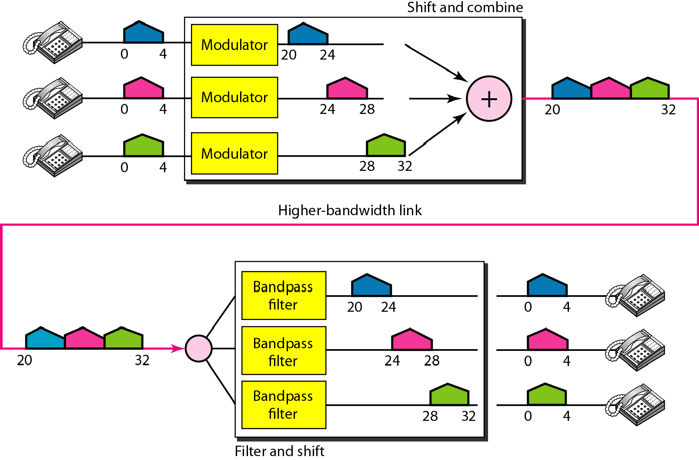
Figure 6.6 Example 6.1

Slide 16
Example 6.2
Five channels, each with a 100-kHz bandwidth, are to be multiplexed together. What is the minimum bandwidth of th link if ther is a need for a guard band of 10 kHz between the channels to prevent interference?
Solution
For five channels, we need at least four guard bands. This means that the required bandwidth is at least
5 × 100 + 4 × 10 = 540 kHz,
as shown in Figure 6.7.

Slide 17
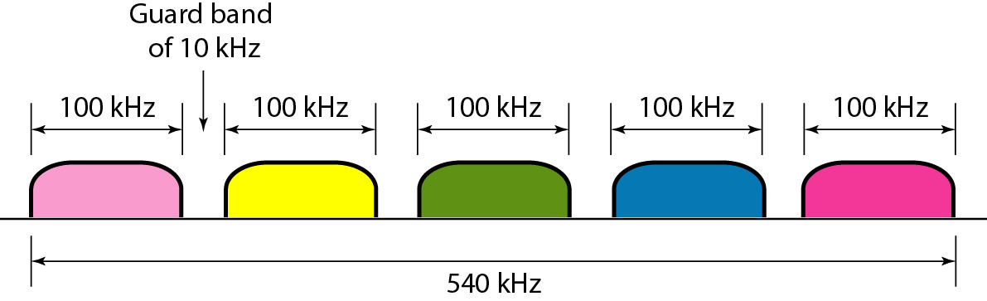
Figure 6.7 Example 6.2

Slide 18
Example 6.3
Four data channels (digital), each transmitting at 1 Mbps, use a satellite channel of 1 MHz. Design an appropriate configuration, using FDM
Solution
The satellite channel is analog. We divide it into four channels, each channel having a 250-kHz bandwidth. Each digital channel of 1 Mbps is modulated such that each 4 bits is modulated to 1 Hz. One solution is 16-QAM modulation. Figure 6.8 shows one possible configuration.

Slide 19
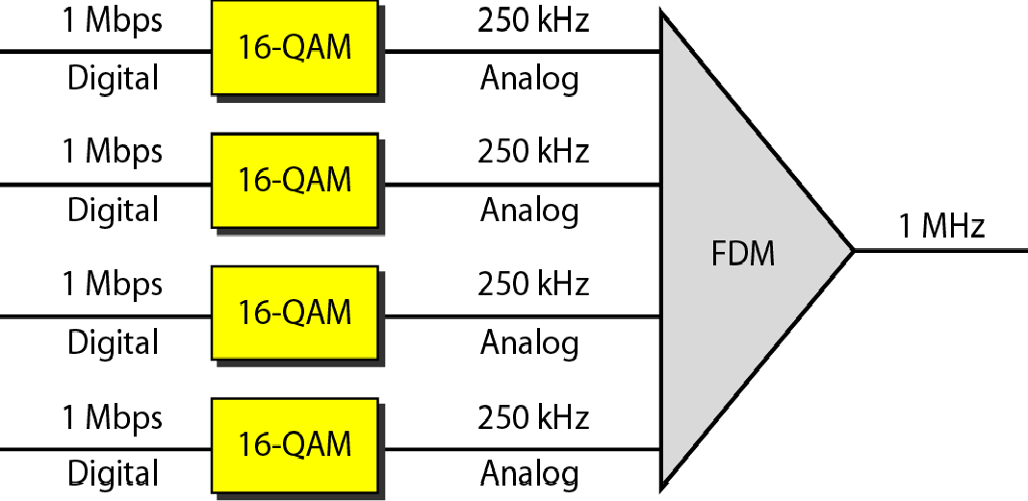
Figure 6.8 Example 6.3

Slide 20
Analog hierarchy
To maximize the efficiency of the infrastructure
In this analog hierarchy, 12 voice channels are multiplexed onto a higher-bandwidth line to create a group. A group has 48 kHz of bandwidth and supports 12 voice channels.
At the next level, up to five groups can be multiplexed to create a composite signal called a supergroup. A supergroup has a bandwidth of 240 kHz and supports up to 60 voice channels. Supergroups can be made up of either five groups or 60 independent voice channels.
At the next level, 10 supergroups are multiplexed to create a master group. A master group must have 2.40 MHz of bandwidth, but the need for guard bands between the supergroups increases the necessary bandwidth to 2.52 MHz. Master groups support up to 600 voice channels.
Finally, six master groups can be combined into a jumbo group. A jumbo group must have 15.12 MHz (6 × 2.52 MHz) but is augmented to 16.984 MHz to allow for guard bands between the master groups

Slide 21
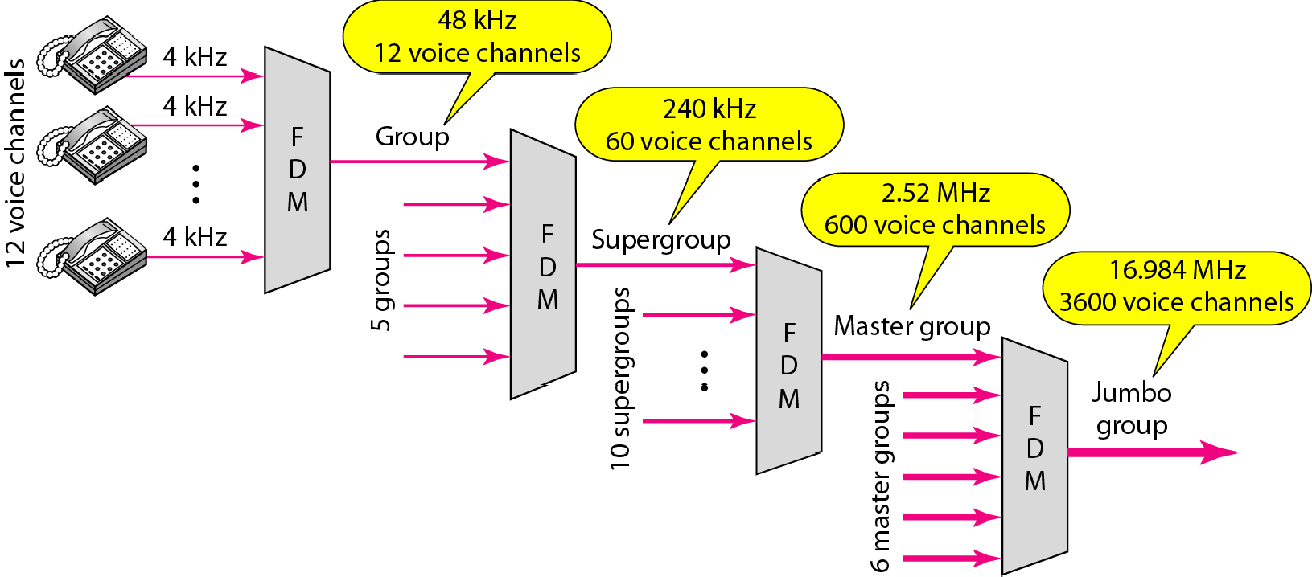
Figure 6.9 Analog hierarchy

Slide 22
Other Applications of FDM
A very common application of FDM is AM and FM radio broadcasting. Radio uses the air as the transmission medium. A special band from 530 to 1700 kHz is assigned to AM radio. All radio stations need to share this band.
The situation is similar in FM broadcasting. However, FM has a wider band of 88 to 108 MHz because each station needs a bandwidth of 200 kHz.
Another common use of FDM is in television broadcasting. Each TV channel has its own bandwidth of 6 MHz
The first generation of cellular telephones (See Chapter 16) also uses FDM. Each user is assigned two 30-kHz channels, one for sending voice and the other for receiving

Slide 23
Example 6.4
The Advanced Mobile Phone System (AMPS) uses two bands The first band of 824 to 849 MHz is used for sending, and 869 to 894 MHz is used for receiving. Each user has a bandwidth of 30 kHz in each direction
How many people can use their cellular phones
simultaneously? Solution
Each band is 25 MHz. If we divide 25 MHz by 30 kHz, we
get 833.33. In reality, the band is divided into 832 channels. Of these, 42 channels are used for control, which means only 790 channels are available for cellular phone users.

Slide 24
Wavelength-division multiplexing
Wavelength-division multiplexing (WDM) is designed to use the high-data-rate capability of fiber-optic cable.
The optical fiber data rate is higher than the data rate of metallic transmission cable, but using a fiber-optic cable for a single line wastes the available bandwidth.
Multiplexing allows us to combine several lines into one.
WDM is conceptually the same as FDM, except that the multiplexing and demultiplexing involve optical signals transmitted through fiber-optic channels.
The idea is the same: We are combining different signals of different frequencies. The difference is that the frequencies are very high.

Slide 25
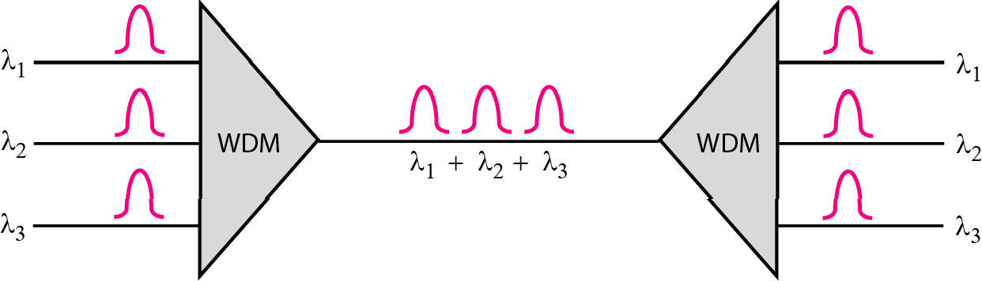
Figure 6.10 Wavelength-division multiplexing

Slide 26
Note
WDM is an analog multiplexing technique to combine optical signals.

Slide 27
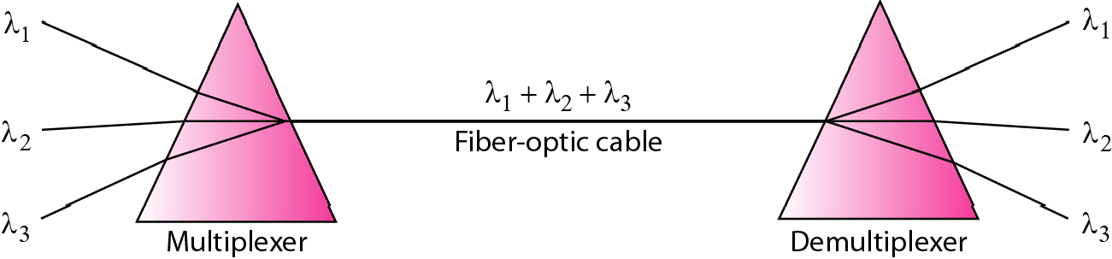
Figure 6.11 Prisms in wavelength-division multiplexing and demultiplexing
One application of WDM is the SONET network, in which multiple optical fiber lines are multiplexed and demultiplexed.

Slide 28
Time-division multiplexing
Time-division multiplexing (TDM) is a digital process that allows several connections to share the high bandwidth of a link.
Instead of sharing a portion of the bandwidth as in FDM, time is shared.
Each connection occupies a portion of time in the link.
Note that the same link is used as in FDM; here, however, the link is shown sectioned by time rather than by frequency.
In the figure, portions of signals 1, 2, 3, and 4 occupy the link sequentially.

Slide 29
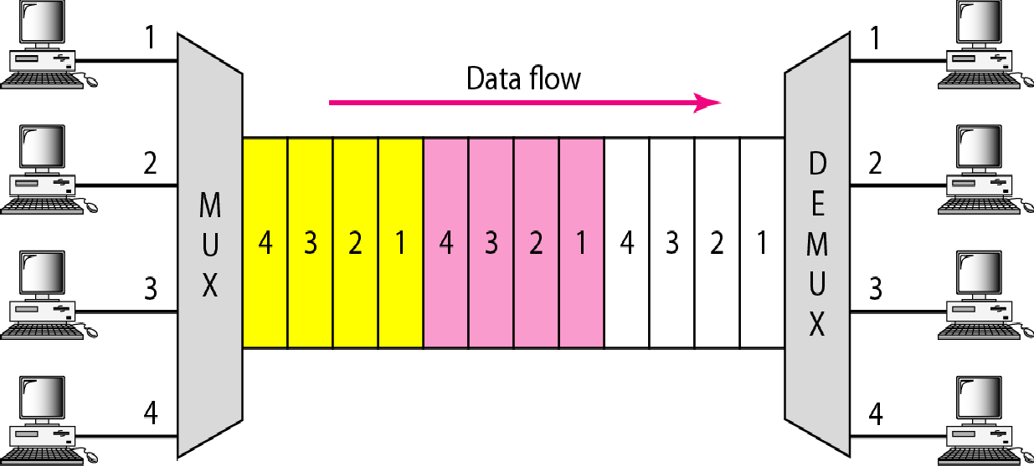
Figure 6.12 TDM

Slide 30

Note
TDM is a digital multiplexing technique for combining several low-rate channels into one high-rate one.
TDM is a digital multiplexing technique

Slide 31
Synchronous TDM
In synchronous TDM, each input connection has an allotment in the output even if it is not sending data.
In synchronous TDM, a round of data units from each input connection is collected into a frame.
If we have n connections, a frame is divided into n time slots and one slot is allocated for each unit, one for each input line
If the duration of the input unit is T, the duration of each slot is T/n and the duration of each frame is T.
The data rate of the output link must be n times the data rate of a connection to guarantee the flow of data.
In Figure 6.13, the data rate of the link is 3 times the data rate of a connection; likewise, the duration of a unit on a connection is 3 times that of the time slot (duration of a unit on the link).
In the figure we represent the data prior to multiplexing as 3 times the size of the data after multiplexing. This is just to convey the idea that each unit is 3 times longer in duration before multiplexing than after.

Slide 32
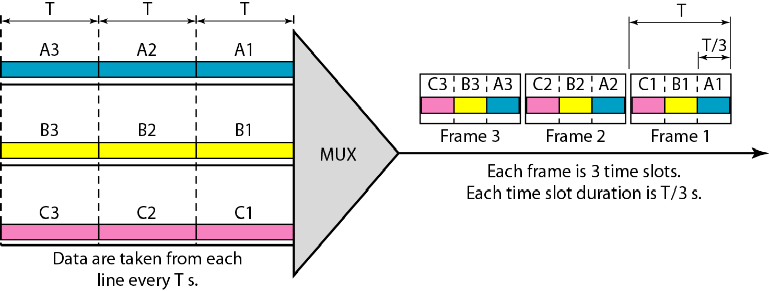
Figure 6.13 Synchronous time-division multiplexing

Slide 33

Note
In synchronous TDM, the data rate of the link is n times faster, and the unit
duration is n times shorter.

Slide 34
Example 6.5
In Figure 6.13, the data rate for each input connection is 1 kbps. If 1 bit at a time is multiplexed (a unit is 1 bit), what is the duration of (a) each input slot, (b) each output slot, and (c) each frame?
Solution
We can answer the questions as follows:
a. The data rate of each input connection is 1 kbps. This means that the bit duration is 1/1000 s or 1 ms. The duration of the input time slot is 1 ms (same as bit duration).

Slide 35
Example 6.5 (continued)
b. The duration of each output time slot is one-third of the input time slot. This means that the duration of the output time slot is 1/3 ms.
c. Each frame carries three output time slots. So the duration of a frame is 3 × 1/3 ms, or 1 ms. The duration of a frame is the same as the duration of an input unit.

Slide 36
Example 6.6
Figure 6.14 shows synchronous TDM with a data stream for each input and one data stream for the output. The unit of data is 1 bit. Find (a) the input bit duration, (b) the output bit duration, (c) the output bit rate, and (d) the output frame rate.
Solution
We can answer the questions as follows:
The input bit duration is the inverse of the bit rate: 1/1 Mbps = 1 μs.
The output bit duration is one-fourth of the input bit duration, or ¼ μs.

Slide 37
Example 6.6 (continued)
c. The output bit rate is the inverse of the output bit duration or 1/(4μs) or 4 Mbps. This can also be deduced from the fact that the output rate is 4 times as fast as any input rate; so the output rate = 4 × 1 Mbps
= 4 Mbps.
d. The frame rate is always the same as any input rate. So the frame rate is 1,000,000 frames per second. Because we are sending 4 bits in each frame, we can verify the result of the previous question by multiplying the frame rate by the number of bits per frame.

Slide 38
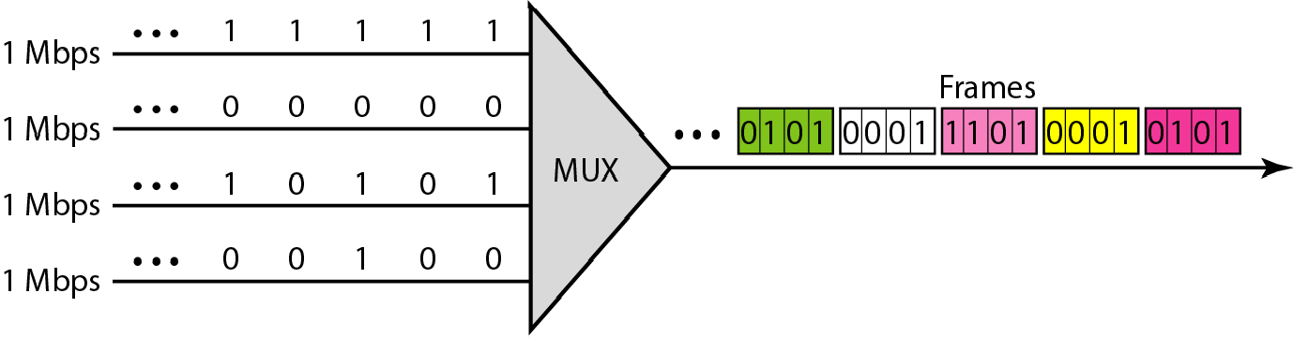
Figure 6.14 Example 6.6

Slide 39
Example 6.7
Four 1-kbps connections are multiplexed together. A unit is 1 bit. Find (a) the duration of 1 bit before multiplexing,
(b) the transmission rate of the link, (c) the duration of a time slot, and (d) the duration of a frame.
Solution
We can answer the questions as follows:
The duration of 1 bit before multiplexing is 1 / 1 kbps, or 0.001 s (1 ms).
The rate of the link is 4 times the rate of a connection, or 4 kbps.

Slide 40
Example 6.7 (continued)
c. The duration of each time slot is one-fourth of the duration of each bit before multiplexing, or 1/4 ms or 250 μs. Note that we can also calculate this from the data rate of the link, 4 kbps. The bit duration is the inverse of the data rate, or 1/4 kbps or 250 μs.
d. The duration of a frame is always the same as the duration of a unit before multiplexing, or 1 ms. We can also calculate this in another way. Each frame in this case has four time slots. So the duration of a frame is 4 times 250 μs, or 1 ms.

Slide 41
INTERLEAVING
TDM can be visualized as two fast-rotating switches, one on the multiplexing side and the other on the demultiplexing side.
The switches are synchronized and rotate at the same speed, but in opposite directions.
On the multiplexing side, as the switch opens in front of a connection, that connection has the opportunity to send a unit onto the path. This process is called interleaving.
On the demultiplexing side, as the switch opens in front of a connection, that connection has the opportunity to receive a unit from the path.
In this figure, we assume that no switching is involved and that the data from the first connection at the multiplexer site go to the first connection at the demultiplexer.

Slide 42
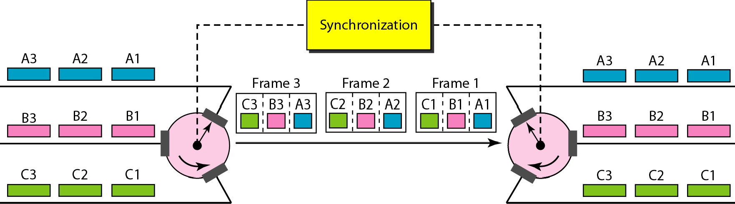
Figure 6.15 Interleaving

Slide 43
Example 6.8
Four channels are multiplexed using TDM. If each channel sends 100 bytes /s and we multiplex 1 byte per channel, show the frame traveling on the link, the size of the frame, the duration of a frame, the frame rate, and the bit rate for the link.
Solution
The multiplexer is shown in Figure 6.16. Each frame carries 1 byte from each channel; the size of each frame, therefore, is 4 bytes, or 32 bits. Because each channel is sending 100 bytes/s and a frame carries 1 byte from each channel, the frame rate must be 100 frames per second. The bit rate is 100 × 32, or 3200 bps.

Slide 44
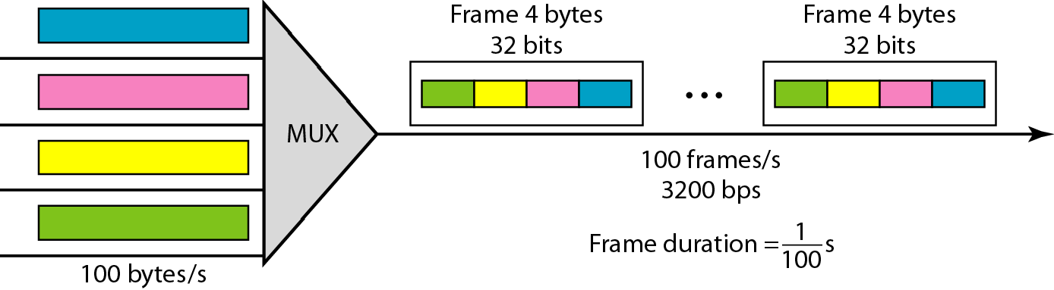
Figure 6.16 Example 6.8

Slide 45
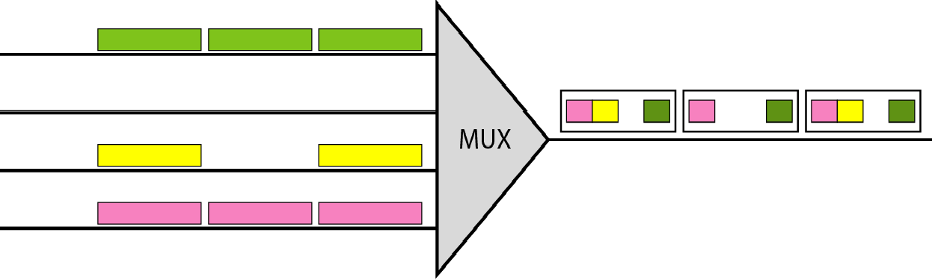
Empty slots
Synchronous TDM is not as efficient as it could be. If a source does not have data to send, the corresponding slot in the output frame is empty.
Figure shows a case in which one of the input lines has no data to send and one slot in another input line has discontinuous data.

Slide 46
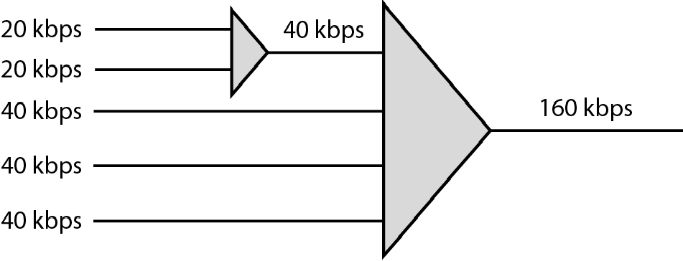
Multilevel multiplexing
Multilevel multiplexing is a technique used when the data rate of an input line is a multiple of others.
For example, in Figure 6.19, we have two inputs of 20 kbps and three inputs of 40 kbps. The first two input lines can be multiplexed together to provide a data rate equal to the last three.
A second level of multiplexing can create an output of 160 kbps

Slide 47
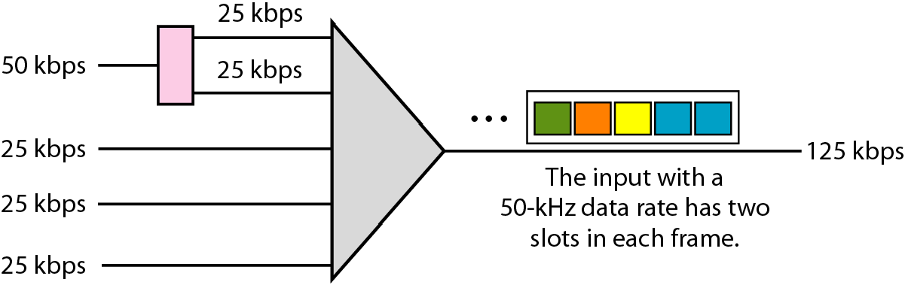
Multiple-slot multiplexing
Sometimes it is more efficient to allot more than one slot in a frame to a single input line.
For example, we might have an input line that has a data rate that is a multiple of another input. In Figure 6.20, the input line with a 50-kbps data rate can be given two slots in the output.
We insert a demultiplexer in the line to make two inputs out of one.

Slide 48
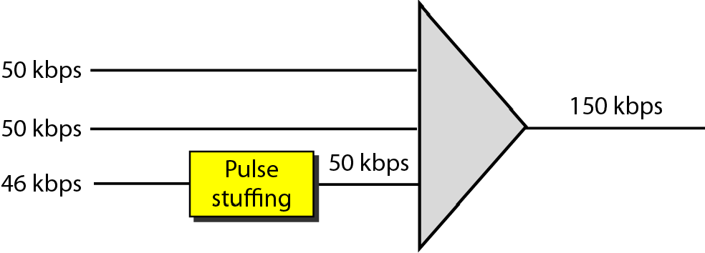
Pulse stuffing
Sometimes the bit rates of sources are not multiple integers of each other. Therefore, neither of the above two techniques can be applied.
One solution is to make the highest input data rate the dominant data rate and then add dummy bits to the input lines with lower rates.
This will increase their rates. This technique is called pulse stuffing, bit padding, or bit stuffing.
The idea is shown in Figure 6.21. The input with a data rate of 46 is pulse-stuffed to increase the rate to 50 kbps. Now multiplexing can take place.

Slide 49
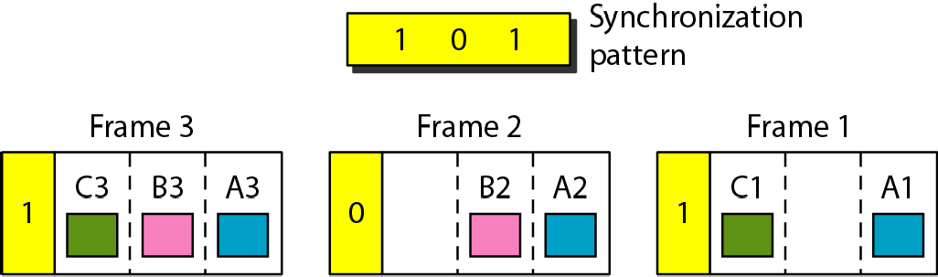
Framing bits
The implementation of TDM is not as simple as that of FDM. Synchronization between the multiplexer and demultiplexer is a major issue.
If the multiplexer and the demultiplexer are not synchronized, a bit belonging to one channel may be received by the wrong channel.
For this reason, one or more synchronization bits are usually added to the beginning of each frame.
These bits, called framing bits, follow a pattern, frame to frame, that allows the demultiplexer to synchronize with the incoming stream so that it can separate the time slots accurately.
In most cases, this synchronization information consists of 1 bit per frame, alternating between 0 and 1

Slide 50
Example 6.10
We have four sources, each creating 250 characters per second. If the interleaved unit is a character and 1 synchronizing bit is added to each frame, find (a) the data rate of each source, (b) the duration of each character in each source, (c) the frame rate, (d) the duration of each frame, (e) the number of bits in each frame, and (f) the data rate of the link.
Solution
We can answer the questions as follows:
a. The data rate of each source is 250 × 8 = 2000 bps = 2 kbps.

Slide 51
Example 6.10 (continued)
Each source sends 250 characters per second; therefore, the duration of a character is 1/250 s, or 4 ms.
Each frame has one character from each source, which means the link needs to send 250 frames per second to keep the transmission rate of each source.
The duration of each frame is 1/250 s, or 4 ms. Note that the duration of each frame is the same as the duration of each character coming from each source.
Each frame carries 4 characters and 1 extra synchronizing bit. This means that each frame is 4 × 8 + 1 = 33 bits.
The link sends 250 frames per second, and each frame contains 33 bits. This means that the data rate of the link is 250 × 33, or 8250 bps.

Slide 52
Example 6.11
Two channels, one with a bit rate of 100 kbps and another with a bit rate of 200 kbps, are to be multiplexed How this can be achieved? What is the frame rate? What is the frame duration? What is the bit rate of the link?
Solution
We can allocate one slot to the first channel and two slots to the second channel. Each frame carries 3 bits. The frame rate is 100,000 frames per second because it carries
1 bit from the first channel. The bit rate is 100,000 frames/s × 3 bits per frame, or 300 kbps.

Slide 53
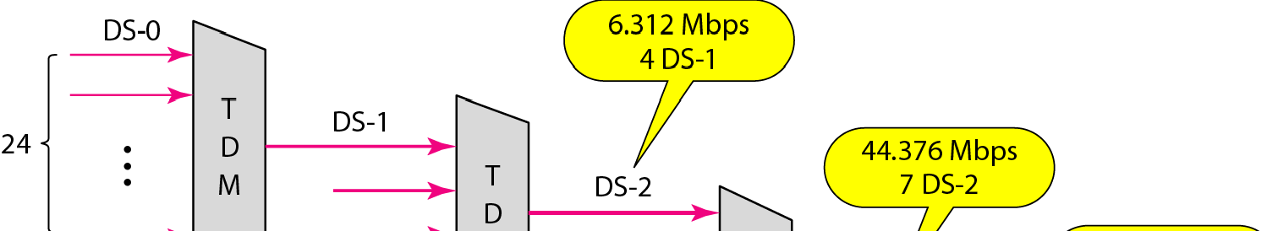
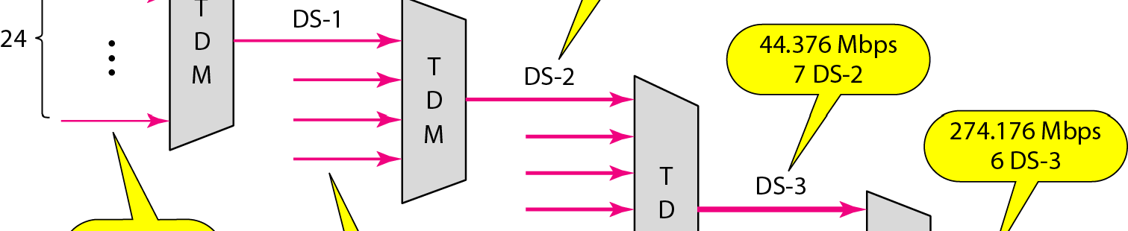
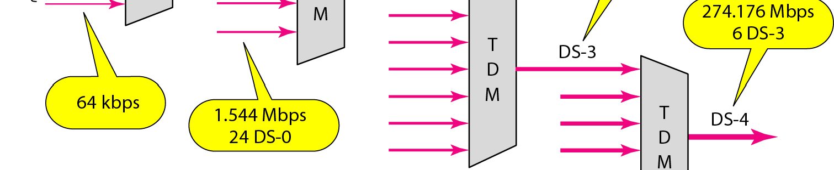
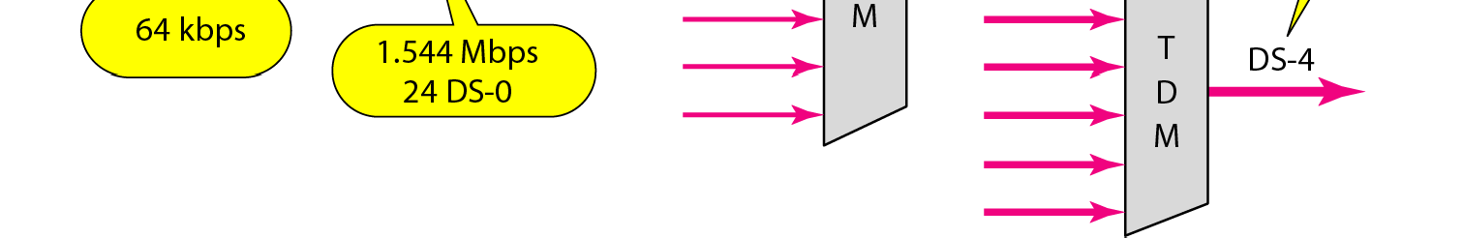
Figure 6.23 Digital hierarchy

Slide 54
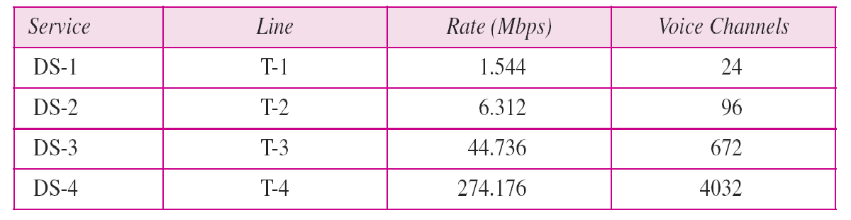
Table 6.1 DS and T line rates
DS-0, DS-1, and so on are the names of services. To implement those services, the telephone companies use T lines (T-1 to T-4). These are lines with capacities precisely matched to the data rates of the DS-1 to DS-4 services (see Table 6.1). So far only T-1 and T-3 lines are commercially available.

Slide 55
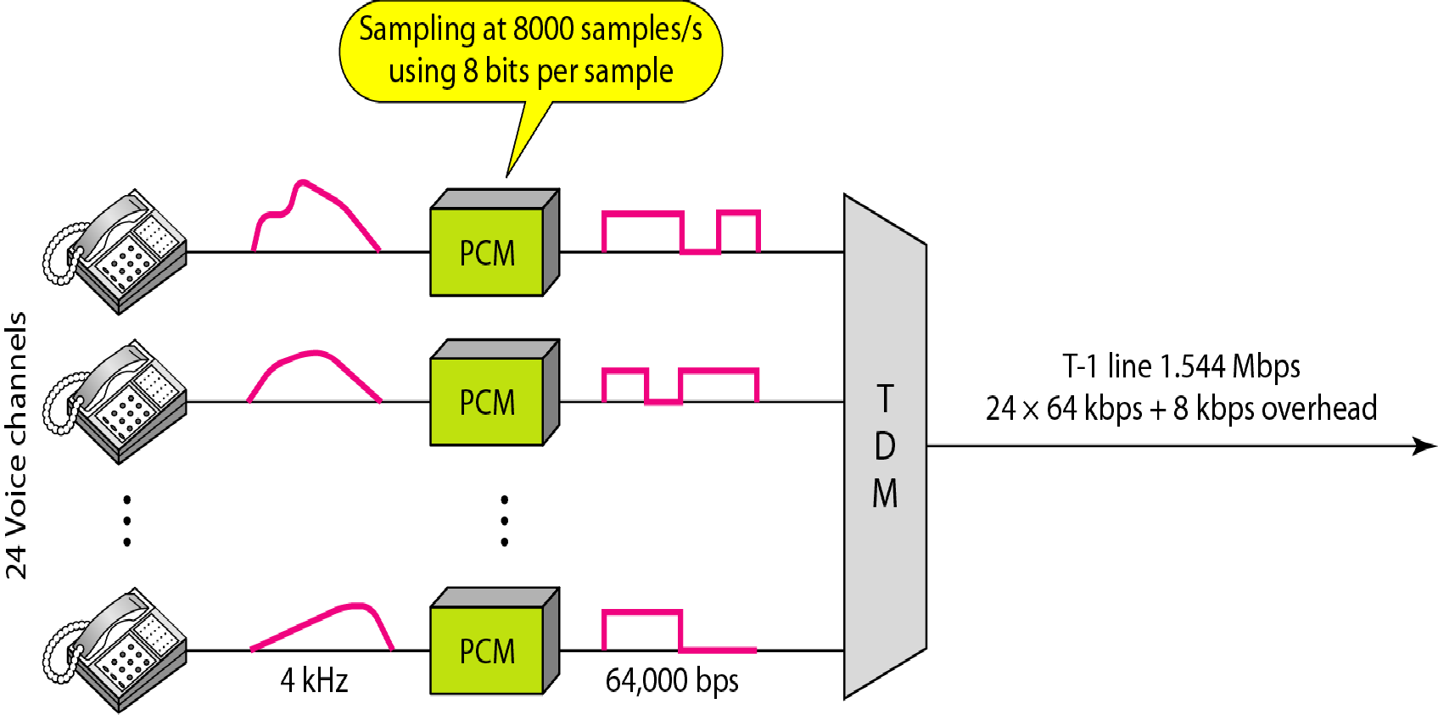
Figure 6.24 T-1 line for multiplexing telephone lines

Slide 56
T-1 line for multiplexing telephone lines
T lines are digital lines designed for the transmission of digital data, audio, or video. However, they also can be used for analog transmission (regular telephone connections), provided the analog signals are first sampled, then time-division multiplexed.
The possibility of using T lines as analog carriers opened up a new generation of services for the telephone companies.
Earlier, when an organization wanted 24 separate telephone lines, it needed to run 24 twisted-pair cables from the company to the central exchange. (Remember those old movies showing a busy executive with 10 telephones lined up on his desk?)
Today, that same organization can combine the 24 lines into one T-1 line and run only the T-1 line to the exchange

Slide 57
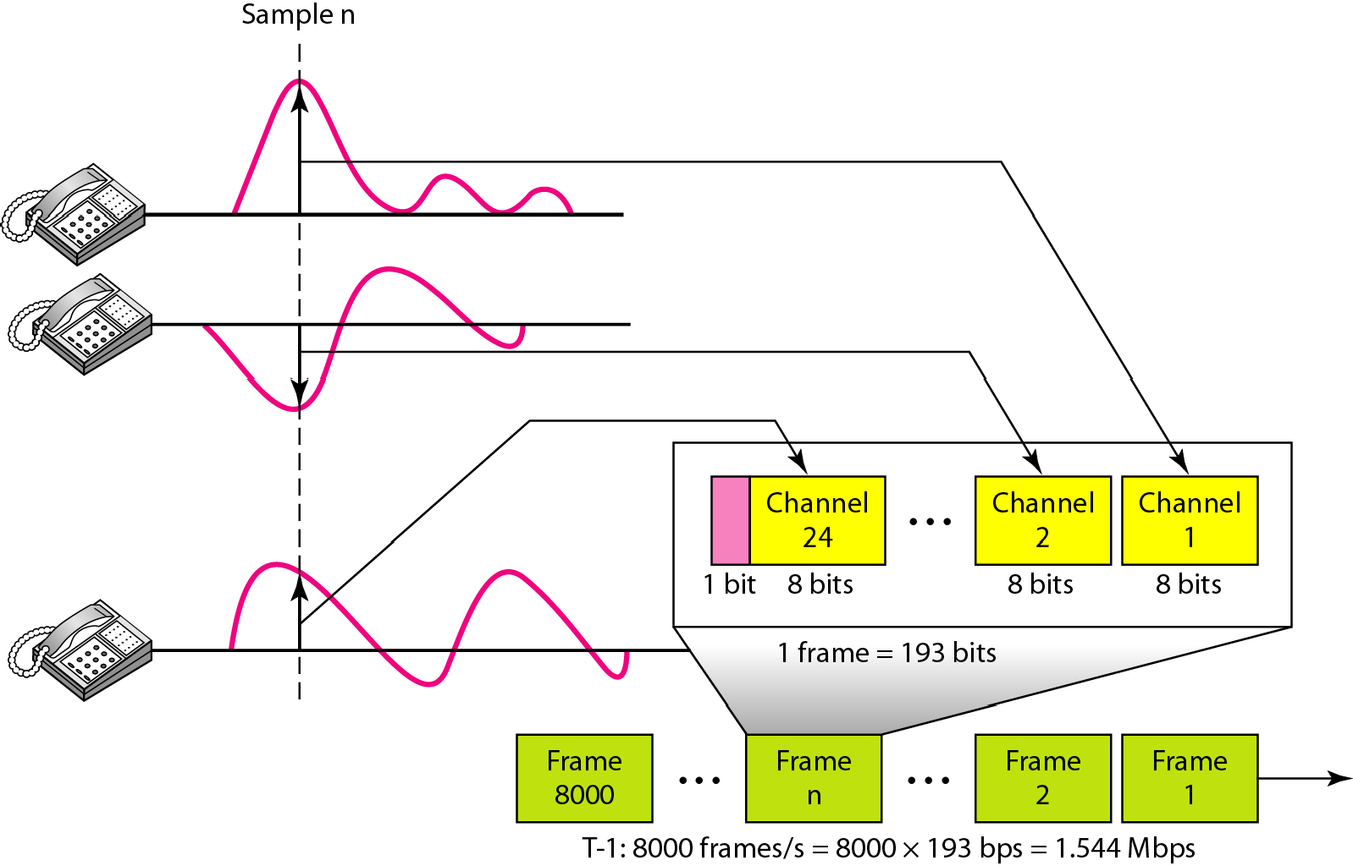
T-1 frame structure
As noted above, DS-1 requires 8 kbps of overhead. To understand how this
overhead is calculated.
The frame used on a T-1 line is usually 193 bits divided into 24 slots of 8 bits each plus 1 extra bit for synchronization (24 × 8 + 1 = 193)

Slide 58
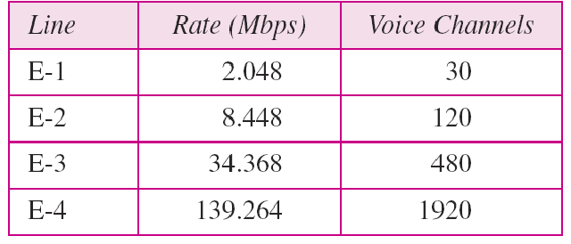
Table 6.2 E line rates

Slide 59
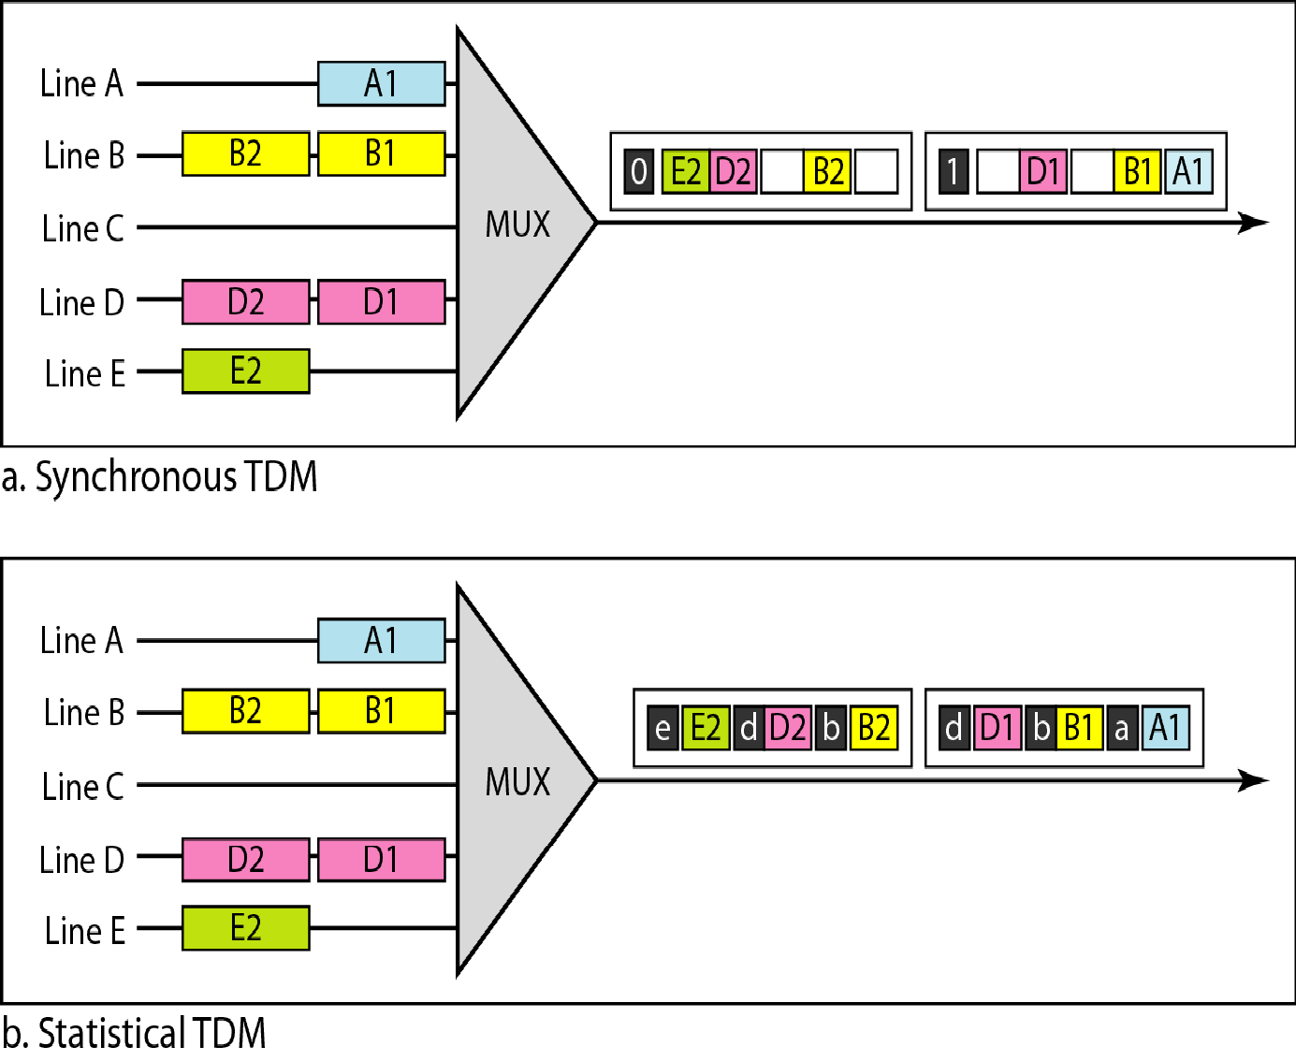
Figure 6.26 TDM slot comparison

Slide 60
Statistical TDM
Addressing
in statistical TDM, a slot needs to carry data as well as the address of the destination
Slot Size.
The addressing in its simplest form can be n bits to define N different output lines with n = log2 N. For example, for eight different output lines, we need a 3-bit address.
Since a slot carries both data and an address in statistical TDM, the ratio of the data size to address size must be reasonable to make transmission efficient
No Synchronization Bit
The frames in statistical TDM need not be synchronized, so we do not need synchronization bits.
Bandwidth
In statistical TDM, the capacity of the link is normally less than the sum of the capacities of each channel.

Slide 61
6-1 SPREAD SPECTRUM
In spread spectrum (SS), we combine signals from different sources to fit into a larger bandwidth, but our goals are to prevent eavesdropping and jamming. To achieve these goals, spread spectrum techniques add redundancy.
Topics discussed in this section:
Frequency Hopping Spread Spectrum (FHSS)
Direct Sequence Spread Spectrum Synchronous (DSSS)

Slide 62
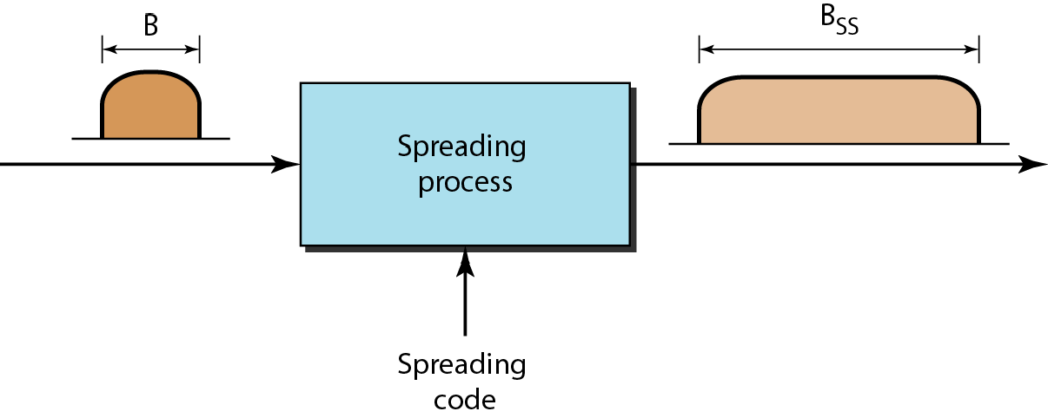
Spread spectrum
Spread spectrum is designed to be used in wireless applications (LANs and WANs)
In wireless applications, all stations use air (or a vacuum) as the medium for communication. Stations must be able to share this medium without interception by an eavesdropper and without being subject to jamming from a malicious intruder (in military operations, for example).

Slide 63
Two principles
Spread spectrum achieves its goals through two principles:
1. The bandwidth allocated to each station needs to be, by far, larger than what is needed. This allows redundancy.
2. The expanding of the original bandwidth B to the bandwidth Bss must be done by a process that is independent of the original signal. In other words, the spreading process occurs after the signal is created by the source.

Slide 64
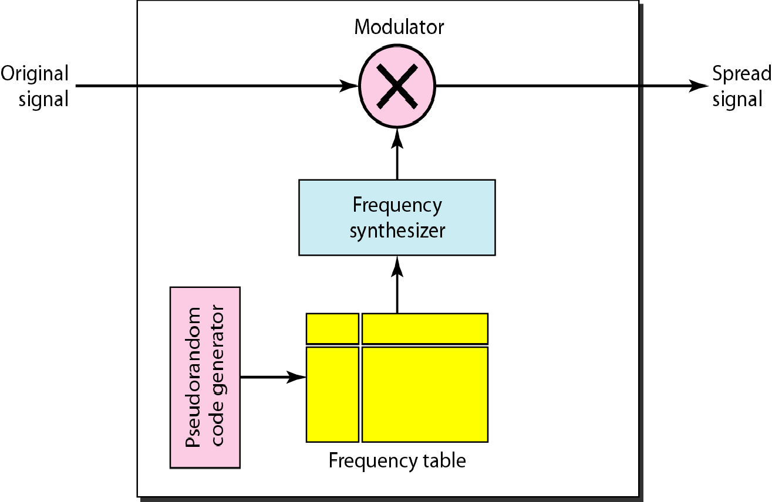
Figure 6.28 Frequency hopping spread spectrum (FHSS)

Slide 65
Frequency hopping spread spectrum (FHSS)
A pseudorandom code generator, called pseudorandom noise (PN), creates a k-bit pattern for every hopping period T.
The frequency table uses the pattern to find the frequency to be used for this hopping period and passes it to the frequency synthesizer.
The frequency synthesizer creates a carrier signal of that frequency, and the source signal modulates the carrier signal.
Suppose we have decided to have eight hopping frequencies. This is extremely low for real applications and is just for illustration. In this case, M is 8 and k is 3.
The pseudorandom code generator will create eight different 3-bit patterns. These are mapped to eight different frequencies in the frequency table

Slide 66
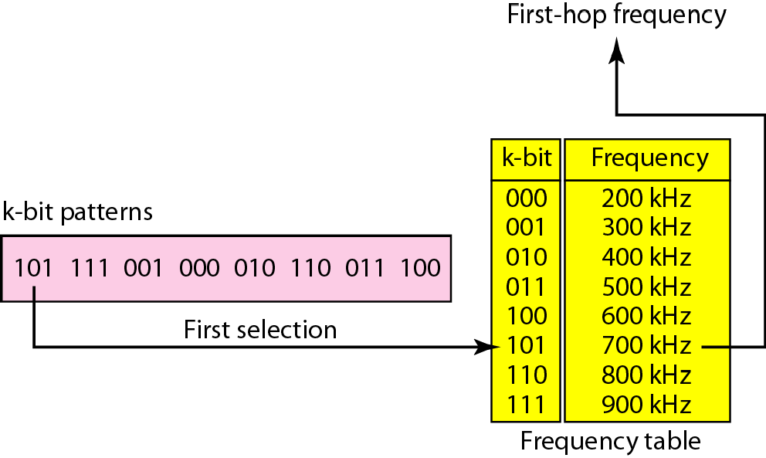
Figure 6.29 Frequency selection in FHSS

Slide 67
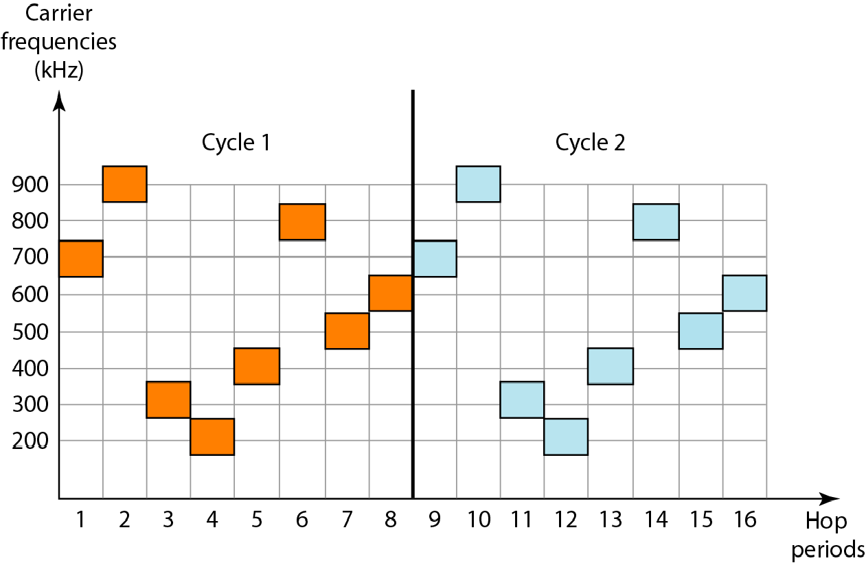
Figure 6.30 FHSS cycles

Slide 68
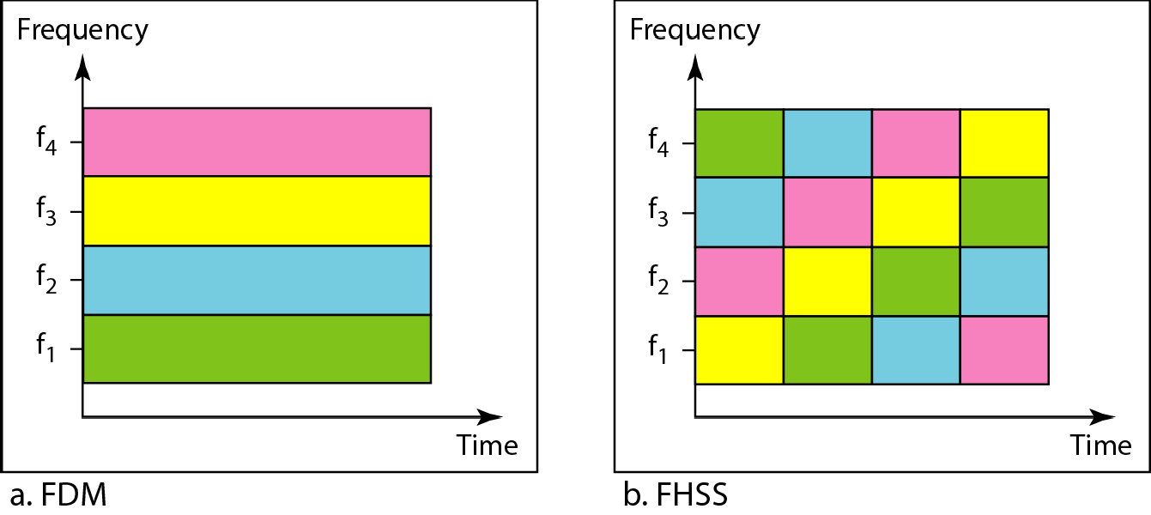
Figure 6.31 Bandwidth sharing

Slide 69
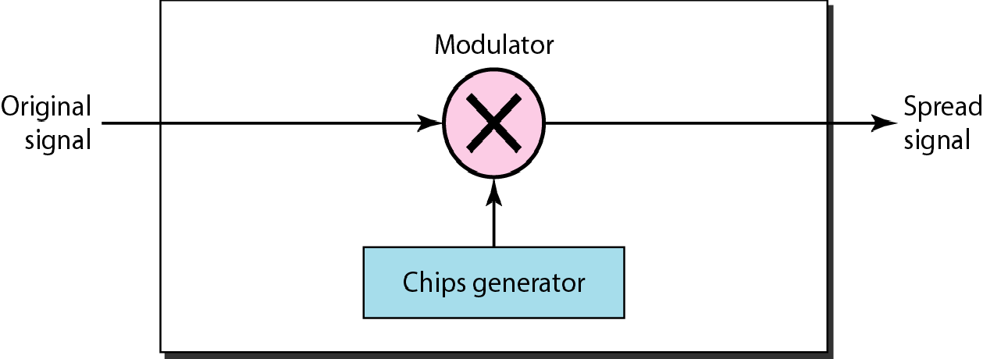
Figure 6.32 DSSS

Slide 70
Direct Sequence Spread Spectrum
The direct sequence spread spectrum (DSSS) technique also expands the bandwidth of the original signal, but the process is different.
In DSSS, we replace each data bit with n bits using a spreading code.
In other words, each bit is assigned a code of n bits, called chips, where the chip rate is n times that of the data bit. Figure 6.32 shows the concept of DSSS.
the spreading code is 11 chips having the pattern 10110111000 (in this case).
If the original signal rate is N, the rate of the spread signal is 11N.
This means that the required bandwidth for the spread signal is 11 times larger than the bandwidth of the original signal.
The spread signal can provide privacy if the intruder does not know the code. It can also provide immunity against interference if each station uses a different code.

Slide 71
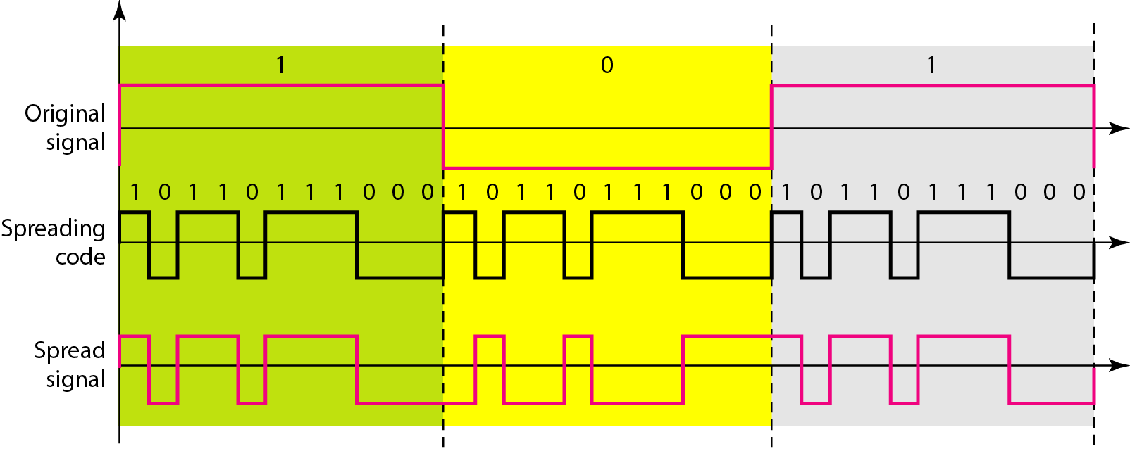
Figure 6.33 DSSS example

Slide 72
Chapter 8 Switching

Slide 73
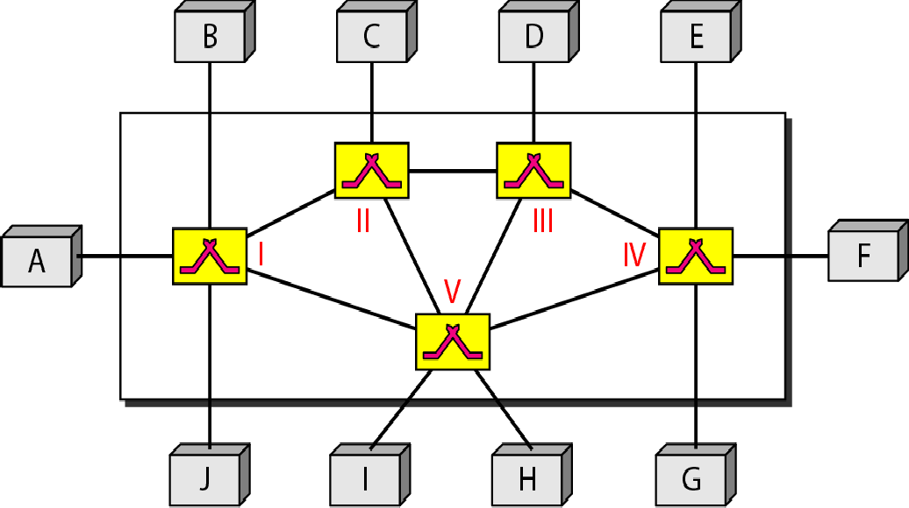
Figure 8.1 Switched network
A switched network consists of a series of interlinked nodes, called switches.
Switches are devices capable of creating temporary connections between two or more devices linked to the switch.

Slide 74
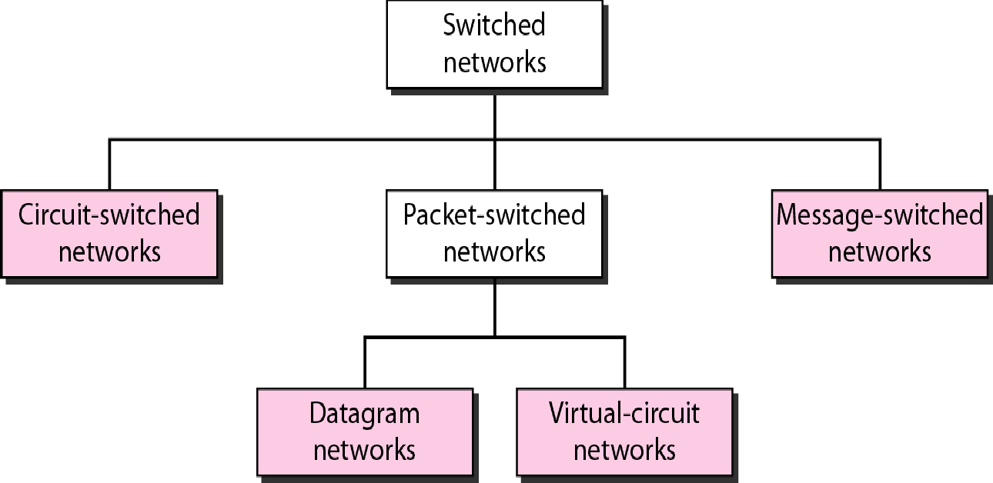
Figure 8.2 Taxonomy of switched networks

Slide 75
8-1 CIRCUIT-SWITCHED NETWORKS
A circuit-switched network consists of a set of switches connected by physical links. A connection between two stations is a dedicated path made of one or more links.. However, each connection uses only one dedicated channel on each link.. Each link is normally divided into n channels by using FDM or TDM.
Topics discussed in this section:
Three Phases Efficiency Delay
Circuit-Switched Technology in Telephone Networks

Slide 76
Note
A circuit-switched network is made of a set of switches connected by physical links, in which each link is
divided into n channels.

Slide 77
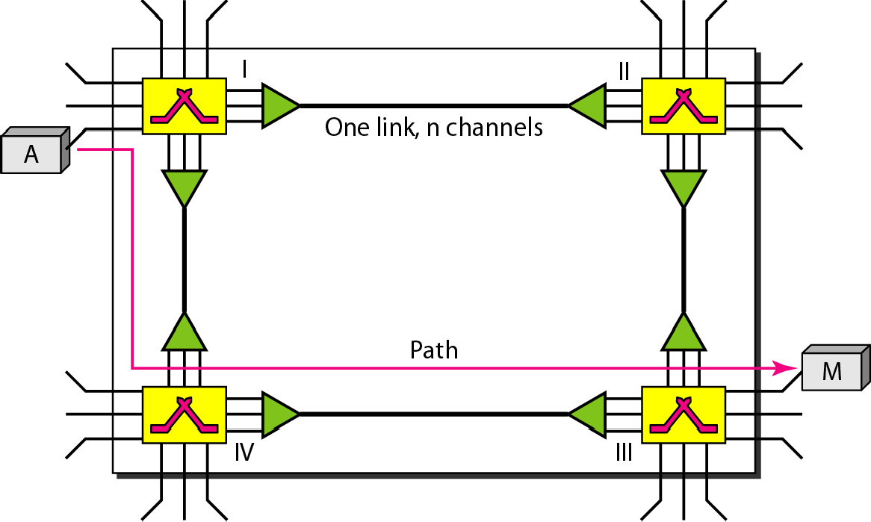
Figure 8.3 A trivial circuit-switched network

Slide 78

Note
In circuit switching, the resources need to be reserved during the setup phase; the resources remain dedicated for the entire duration of data transfer until the teardown phase.

Slide 79
Example 8.1
As a trivial example, let us use a circuit-switched network to connect eight telephones in a small area. Communication is through 4-kHz voice channels. We assume that each link uses FDM to connect a maximum of two voice channels. The bandwidth of each link is then 8 kHz. Figure 8.4 shows the situation. Telephone 1 is connected to telephone 7; 2 to 5; 3 to 8; and 4 to 6. Of course the situation may change when new connections are made. The switch controls the connections.

Slide 80
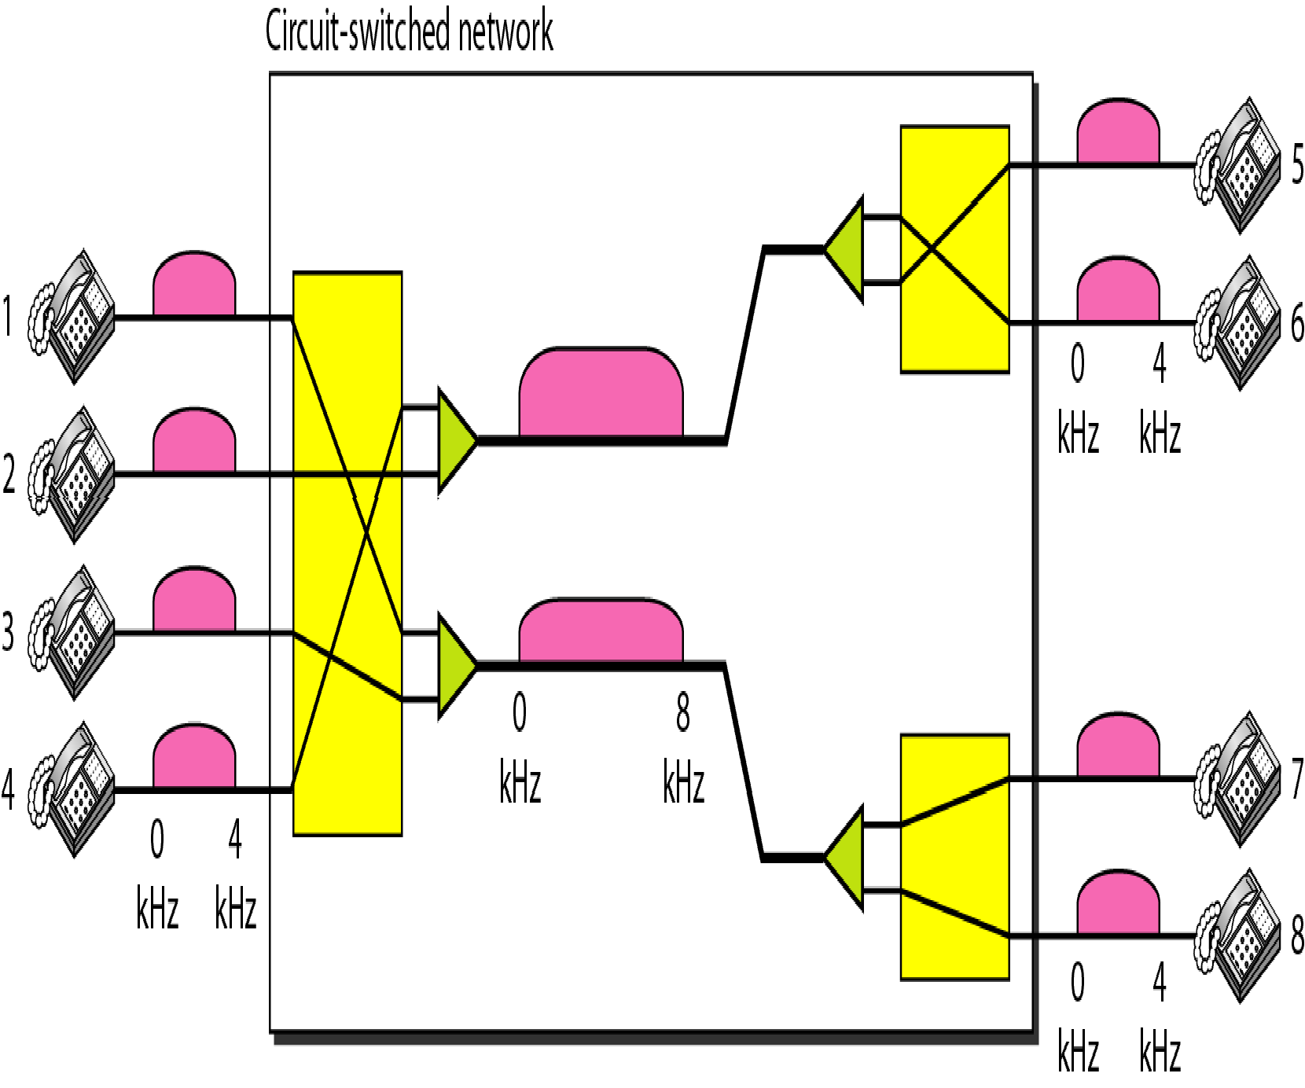
Figure 8.4 Circuit-switched network used in Example 8.1

Slide 81
Example 8.2
As another example, consider a circuit-switched network that connects computers in two remote offices of a private company. The offices are connected using a T-1 line leased from a communication service provider. There are two 4 × 8 (4 inputs and 8 outputs) switches in this network. For each switch, four output ports are folded into the input ports to allow communication between computers in the same office. Four other output ports allow communication between the two offices. Figure 8.5 shows the situation.

Slide 82
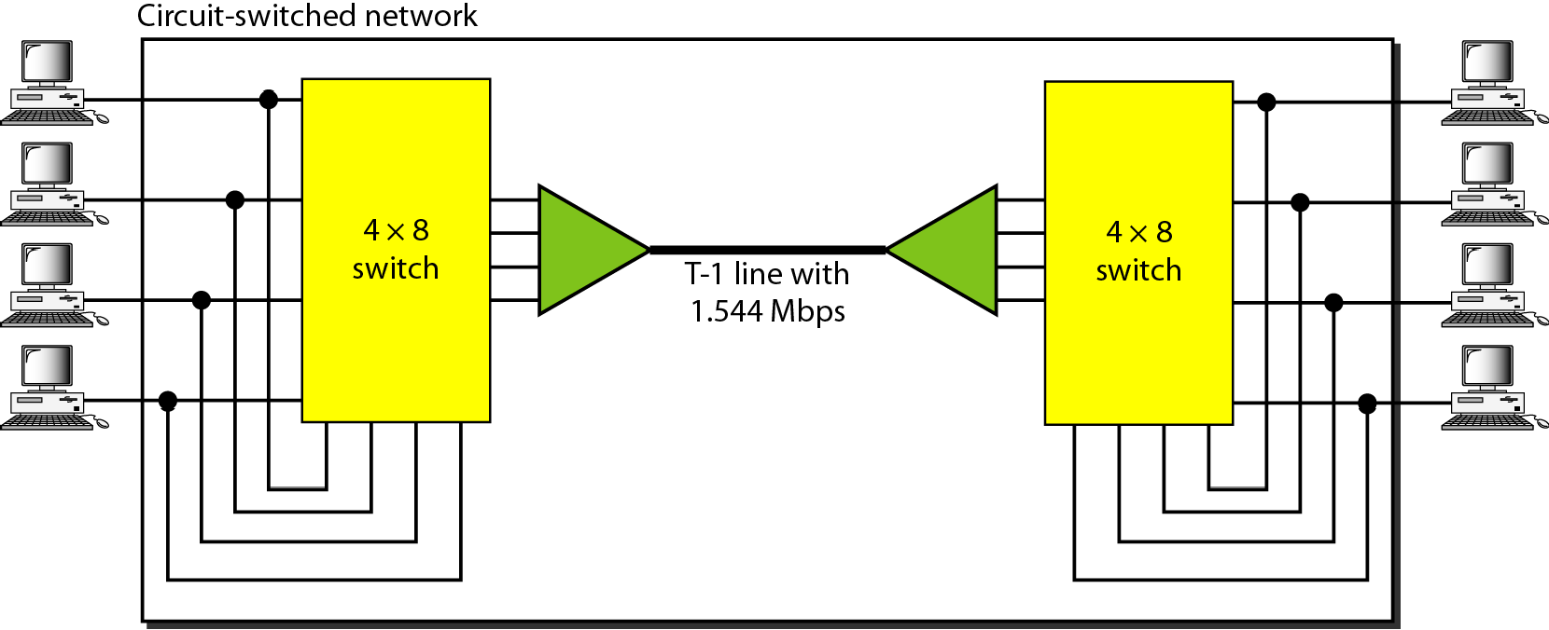
Figure 8.5 Circuit-switched network used in Example 8.2

Slide 83
Three Phases
Setup Phase
Before the two parties (or multiple parties in a conference call) can communicate, a dedicated circuit (combination of channels in links) needs to be established.
The end systems are normally connected through dedicated lines to the switches, so connection setup means creating dedicated channels between the switches.
Data-Transfer Phase
After the establishment of the dedicated circuit (channels), the two parties can transfer data.
Teardown Phase
When one of the parties needs to disconnect, a signal is sent to each switch to release the resources.

Slide 84
Efficiency
It can be argued that circuit-switched networks are not as efficient as the other two types of networks because resources are allocated during the entire duration of the connection.
These resources are unavailable to other connections. In a telephone network, people normally terminate the communication when they have finished their conversation.
However, in computer networks, a computer can be connected to another computer even if there is no activity for a long time. In this case, allowing resources to be dedicated means that other connections are deprived.

Slide 85
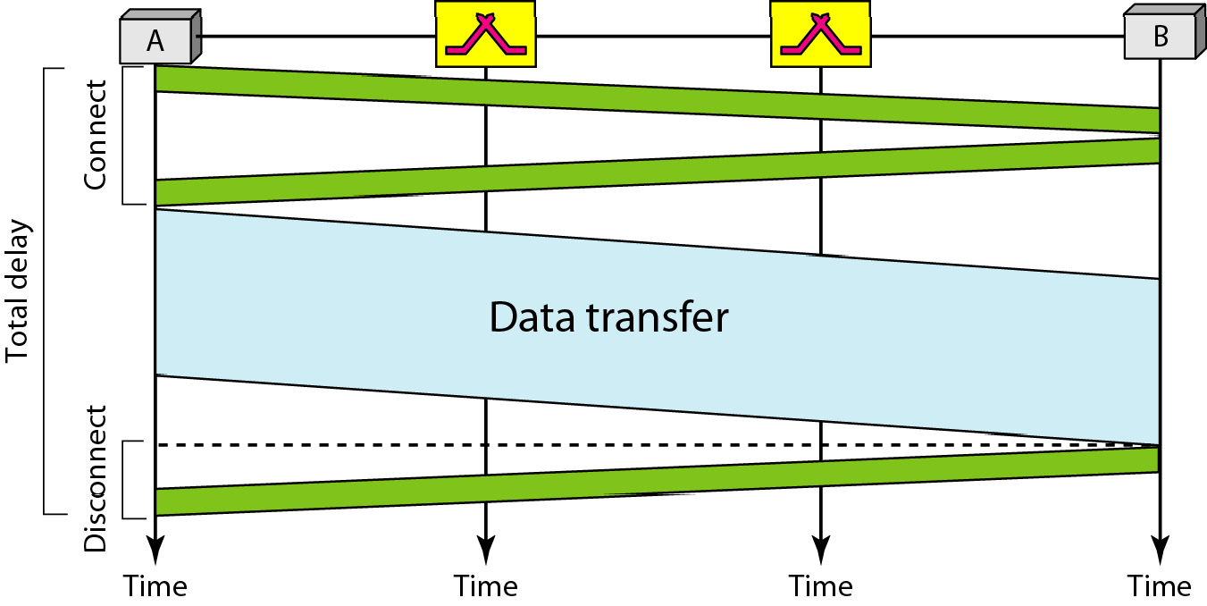
Figure 8.6 Delay in a circuit-switched network

Slide 86

Note
Switching at the physical layer in the traditional telephone network uses the circuit-switching approach.

Slide 87
8-2 PACKET SWITCHING
In data communications, we need to send messages from one end system to another. If the message is going to pass through a packet-switched network, it needs to be divided into packets of fixed or variable size.. The size of the packet is determined by the network and the governing protocol.
Topics discussed in this section:
Routing Table Efficiency Delay
Datagram Networks in the Internet

Slide 88
Note
In a packet-switched network, there is no resource reservation; resources are allocated on demand.

Slide 89
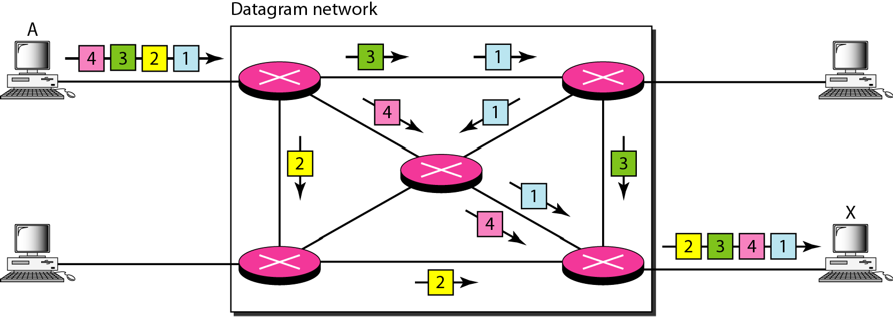
Figure 8.7 A datagram network with four switches (routers)

Slide 90
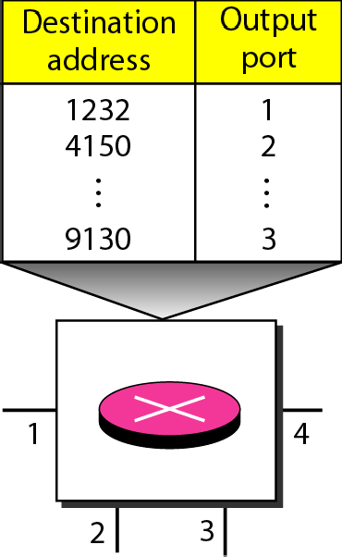
Figure 8.8 Routing table in a datagram network

Slide 91
Note
A switch in a datagram network uses a routing table that is based on the destination address.

Slide 92
Note
The destination address in the header of a packet in a datagram network
remains the same during the entire journey of the packet.

Slide 93
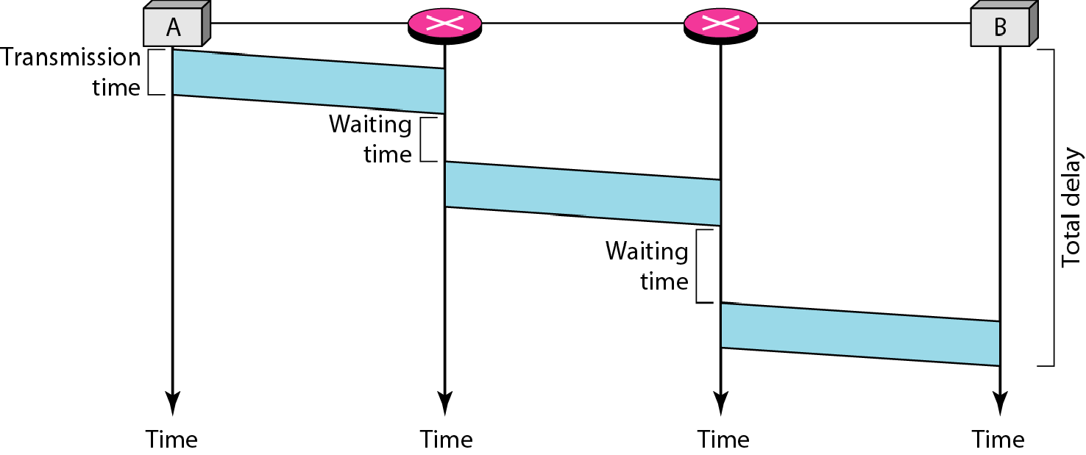
Figure 8.9 Delay in a datagram network
Total delay = 3T + 3τ + w1 + w2

Slide 94
Note
Switching in the Internet is done by using the datagram approach
to packet switching at the network layer.

Slide 95
8-3 VIRTUAL-CIRCUIT NETWORKS
A virtual-circuit network is a cross between a circuit- switched network and a datagram network. It has some characteristics of both.
Topics discussed in this section:
Addressing Three Phases Efficiency Delay
Circuit-Switched Technology in WANs

Slide 96
VIRTUAL-CIRCUIT NETWORKS
1. As in a circuit-switched network, there are setup and teardown phases in addition to the data transfer phase.
2. Resources can be allocated during the setup phase, as in a circuit-switched network, or on demand, as in a datagram network.
3. As in a datagram network, data are packetized and each packet carries an address in the header. However, the address in the header has local jurisdiction (it defines what the next switch should be and the channel on which the packet is being carried), not end-to-end jurisdiction. The reader may ask how the intermediate switches know where to send the packet if there is no final destination address carried by a packet. The answer will be clear when we discuss virtual-circuit identifiers in the next section.
4. As in a circuit-switched network, all packets follow the same path established during the connection

Slide 97
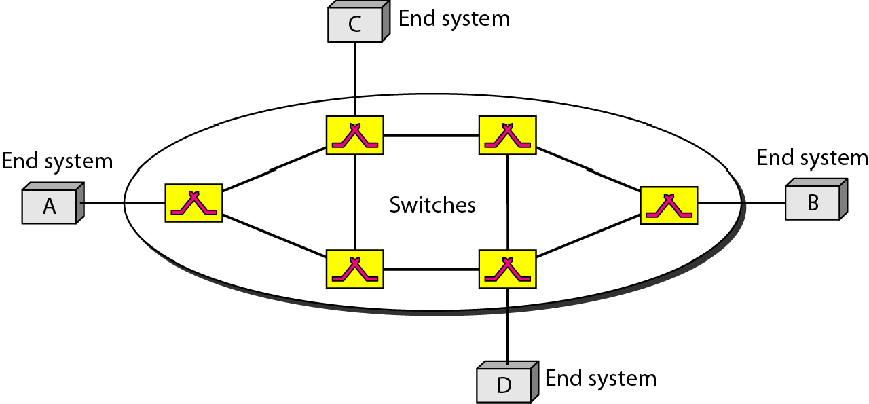
Figure 8.10 Virtual-circuit network

Slide 98
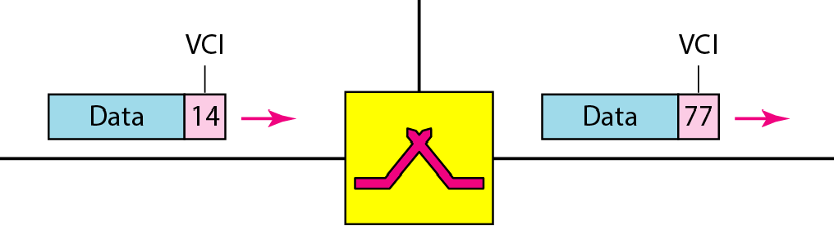
Figure 8.11 Virtual-circuit identifier
Global Addressing
A source or a destination needs to have a global address—an address that can be unique in the scope of the network or internationally if the network is part of an international network.
Virtual-circuit identifier
The identifier that is actually used for data transfer is called the virtual-circuit identifier (VCI) or the label. A VCI, unlike a global address, is a small number that has only switch scope; it is used by a frame between two switches. When a frame arrives at a switch, it has a VCI; when it leaves, it has a different VCI.

Slide 99
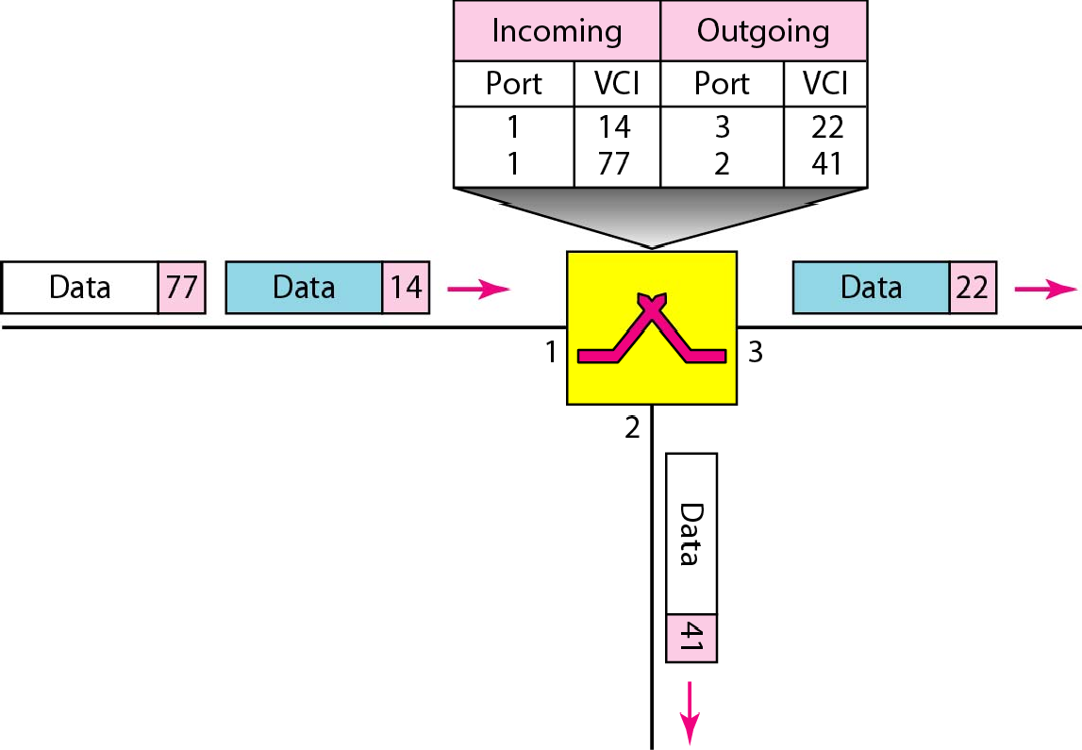
Figure 8.12 Switch and tables in a virtual-circuit network
Three Phases : Setup , Data Transfer, Teardown

Slide 100
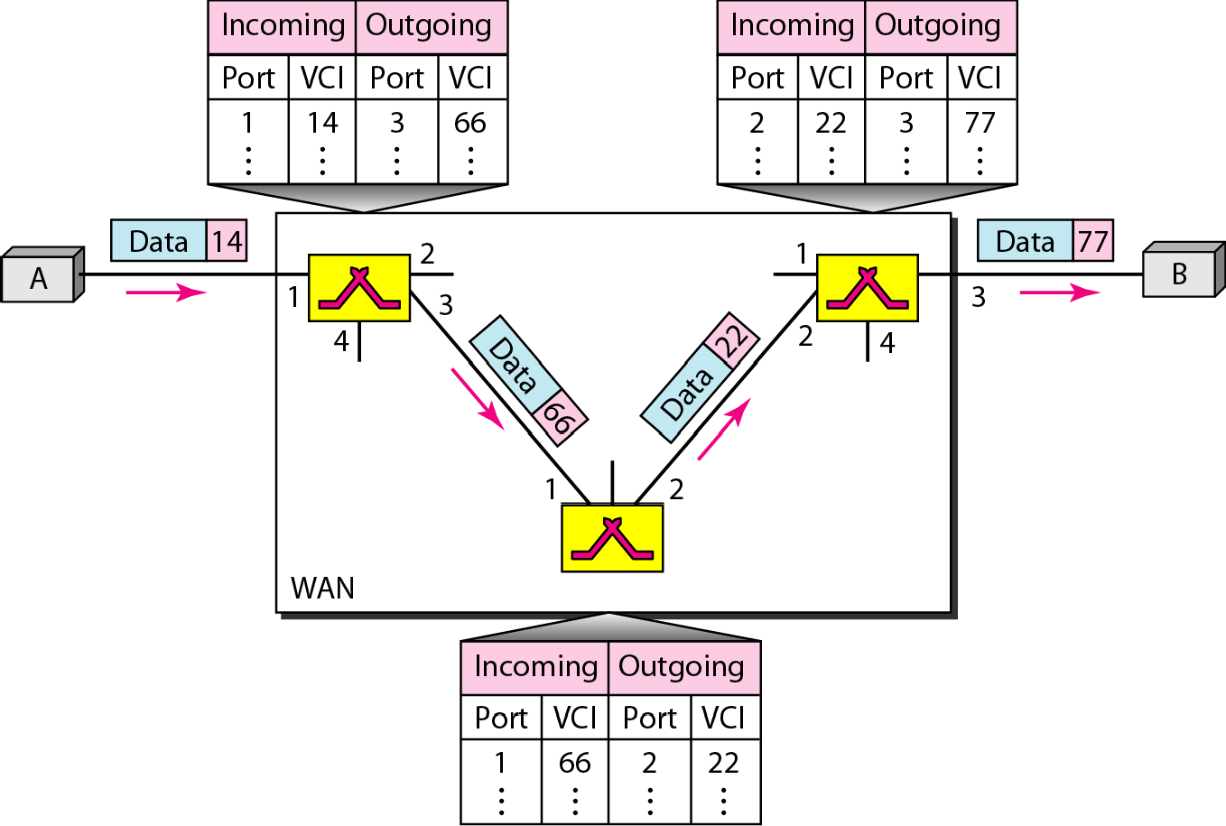
Figure 8.13 Source-to-destination data transfer in a virtual-circuit network

Slide 101

Figure 8.14 Setup request in a virtual-circuit network

Slide 102

Figure 8.15 Setup acknowledgment in a virtual-circuit network

Slide 103
Note
In virtual-circuit switching, all packets belonging to the same source and destination travel the same path; but the packets may arrive at the
destination with different delays
if resource allocation is on demand.

Slide 104

Figure 8.16 Delay in a virtual-circuit network
Total delay = 3T + 3τ + setup delay + teardown delay

Slide 105

Note
Switching at the data link layer in a switched WAN is normally implemented by using
virtual-circuit techniques.

Slide 106
Chapter 10
Error Detection and Correction

Slide 107
Note
Data can be corrupted during transmission.
Some applications require that errors be detected and corrected.

Slide 108
10-1 INTRODUCTION
Let us first discuss some issues related, directly or indirectly, to error detection and correction.
Topics discussed in this section:
Types of Errors Redundancy Detection Versus Correction Forward Error Correction Versus Retransmission Coding
Modular Arithmetic

Slide 109
Note
In a single-bit error, only 1 bit in the data unit has changed.

Slide 110

Figure 10.1 Single-bit error

Slide 111
Note
A burst error means that 2 or more bits in the data unit have changed.

Slide 112

Figure 10.2 Burst error of length 8

Slide 113
Note
To detect or correct errors, we need to send extra (redundant) bits with data.

Slide 114

Figure 10.3 The structure of encoder and decoder

Slide 115
Note
In this book, we concentrate on block codes; we leave convolution codes to advanced texts.

Slide 116
Note
In modulo-N arithmetic, we use only the integers in the range 0 to N −1, inclusive.

Slide 117

Figure 10.4 XORing of two single bits or two words

Slide 118
10-2 BLOCK CODING
In block coding, we divide our message into blocks, each of k bits, called datawords. We add r redundant bits to each block to make the length n = k + r. The resulting n-bit blocks are called codewords.
Topics discussed in this section:
Error Detection Error Correction Hamming Distance
Minimum Hamming Distance

Slide 119
BLOCK CODING
In block coding, we divide our message into blocks, each of k bits, called datawords.
We add r redundant bits to each block to make the length n = k + r. The resulting n-bit blocks are called codewords.
How the extra r bits are chosen or calculated is something we will discuss later.
For the moment, it is important to know that we have a set of datawords, each of size k, and a set of codewords, each of size of n.
With k bits, we can create a combination of 2^{k} datawords; with n bits, we can create a combination of 2^{n} codewords.
Since n > k, the number of possible codewords is larger than the number of possible datawords.

Slide 120

Figure 10.5 Datawords and codewords in block coding

Slide 121
Example 10.1
The 4B/5B block coding discussed in Chapter 4 is a good example of this type of coding. In this coding scheme, k = 4 and n = 5. As we saw, we have 2^{k} = 16 datawords and 2^{n} = 32 codewords. We saw that 16 out of 32 codewords are used for message transfer and the rest are either used for other purposes or unused.

Slide 122
Error Detection
How can errors be detected by using block coding? If the following two conditions are met, the receiver can detect a change in the original codeword.
The receiver has (or can find) a list of valid codewords.
The original codeword has changed to an invalid one
The sender creates codewords out of datawords by using a generator that applies the rules and procedures of encoding (discussed later).
Each codeword sent to the receiver may change during transmission.
If the received codeword is the same as one of the valid codewords, the word is accepted; the corresponding dataword is extracted for use.
If the received codeword is not valid, it is discarded.
However, if the codeword is corrupted during transmission but the received word still matches a valid codeword, the error remains undetected.

Slide 123

Figure 10.6 Process of error detection in block coding

Slide 124
Example 10.2
Let us assume that k = 2 and n = 3. Table 10.1 shows the list of datawords and codewords. Later, we will see how to derive a codeword from a dataword.
Assume the sender encodes the dataword 01 as 011 and
sends it to the receiver. Consider the following cases:
1. The receiver receives 011. It is a valid codeword. The receiver extracts the dataword 01 from it.

Slide 125
Example 10.2 (continued)
2. The codeword is corrupted during transmission, and 111 is received. This is not a valid codeword and is discarded.
3. The codeword is corrupted during transmission, and 000 is received. This is a valid codeword. The receiver incorrectly extracts the dataword 00. Two corrupted bits have made the error undetectable.

Slide 126

Table 10.1 A code for error detection (Example 10.2)

Slide 127
Note
An error-detecting code can detect only the types of errors for which it is designed; other types of errors may remain undetected.

Slide 128

Figure 10.7 Structure of encoder and decoder in error correction

Slide 129
Example 10.3
Let us add more redundant bits to Example 10.2 to see if the receiver can correct an error without knowing what was actually sent. We add 3 redundant bits to the 2-bit dataword to make 5-bit codewords. Table 10.2 shows the datawords and codewords. Assume the dataword is 01. The sender creates the codeword 01011. The codeword is corrupted during transmission, and 01001 is received. First, the receiver finds that the received codeword is not in the table. This means an error has occurred. The receiver, assuming that there is only 1 bit corrupted, uses the following strategy to guess the correct dataword.

Slide 130
Example 10.3 (continued)
1. Comparing the received codeword with the first codeword in the table (01001 versus 00000), the receiver decides that the first codeword is not the one that was sent because there are two different bits.
2. By the same reasoning, the original codeword cannot be the third or fourth one in the table.
3. The original codeword must be the second one in the table because this is the only one that differs from the received codeword by 1 bit. The receiver replaces 01001 with 01011 and consults the table to find the dataword 01.

Slide 131

Table 10.2 A code for error correction (Example 10.3)

Slide 132
Note
The Hamming distance between two words is the number of differences between corresponding bits.

Slide 133

Example 10.4
Let us find the Hamming distance between two pairs of words.
1. The Hamming distance d(000, 011) is 2 because
2. The Hamming distance d(10101, 11110) is 3 because

Slide 134
Note
The minimum Hamming distance is the smallest Hamming distance between all possible pairs in a set of words.

Slide 135
Example 10.5
Find the minimum Hamming distance of the coding scheme in Table 10.1.
Solution
We first find all Hamming distances.
The d_{min} in this case is 2.

Slide 136
Example 10.6
Find the minimum Hamming distance of the coding scheme in Table 10.2.
Solution
We first find all the Hamming distances.
The d_{min} in this case is 3.

Slide 137
Note
To guarantee the detection of up to s errors in all cases, the minimum Hamming distance in a block code must be d_{min} = s + 1.

Slide 138
Example 10.7
The minimum Hamming distance for our first code scheme (Table 10.1) is 2. This code guarantees detection of only a single error. For example, if the third codeword (101) is sent and one error occurs, the received codeword does not match any valid codeword. If two errors occur, however, the received codeword may match a valid codeword and the errors are not detected.

Slide 139
Example 10.8
Our second block code scheme (Table 10.2) has d_{min} = 3. This code can detect up to two errors. Again, we see that when any of the valid codewords is sent, two errors create a codeword which is not in the table of valid codewords. The receiver cannot be fooled.
However, some combinations of three errors change a valid codeword to another valid codeword. The receiver accepts the received codeword and the errors are undetected.

Slide 140

Figure 10.8 Geometric concept for finding d_{min} in error detection

Slide 141

Figure 10.9 Geometric concept for finding d_{min} in error correction

Slide 142
Note
To guarantee correction of up to t errors in all cases, the minimum Hamming distance in a block code must be d_{min} = 2t + 1.

Slide 143
Example 10.9
A code scheme has a Hamming distance d_{min} = 4. What is the error detection and correction capability of this scheme?
Solution
This code guarantees the detection of up to three errors (s = 3), but it can correct up to one error. In other words, if this code is used for error correction, part of its capability is wasted. Error correction codes need to have an odd minimum distance (3, 5, 7, . . . ).

Slide 144
10-3 LINEAR BLOCK CODES
Almost all block codes used today belong to a subset called linear block codes. A linear block code is a code in which the exclusive OR (addition modulo-2) of two valid codewords creates another valid codeword.
Topics discussed in this section:
Minimum Distance for Linear Block Codes Some Linear Block Codes

Slide 145
Note
In a linear block code, the exclusive OR (XOR) of any two valid codewords creates another valid codeword.

Slide 146
Example 10.10
Let us see if the two codes we defined in Table 10.1 and Table 10.2 belong to the class of linear block codes.
1. The scheme in Table 10.1 is a linear block code because the result of XORing any codeword with any other codeword is a valid codeword. For example, the XORing of the second and third codewords creates the fourth one.
2. The scheme in Table 10.2 is also a linear block code. We can create all four codewords by XORing two other codewords.

Slide 147
Example 10.11
In our first code (Table 10.1), the numbers of 1s in the nonzero codewords are 2, 2, and 2. So the minimum Hamming distance is d_{min} = 2. In our second code (Table 10.2), the numbers of 1s in the nonzero codewords are 3, 3, and 4. So in this code we have d_{min} = 3.

Slide 148
Note
A simple parity-check code is a single-bit error-detecting code in which n = k + 1 with d_{min} = 2.

Slide 149

Table 10.3 Simple parity-check code C(5, 4)

Slide 150

Figure 10.10 Encoder and decoder for simple parity-check code

Slide 151
Example 10.12
Let us look at some transmission scenarios. Assume the sender sends the dataword 1011. The codeword created from this dataword is 10111, which is sent to the receiver. We examine five cases:
1. No error occurs; the received codeword is 10111. The syndrome is 0. The dataword 1011 is created.
2. One single-bit error changes a₁ . The received codeword is 10011. The syndrome is 1. No dataword is created.
3. One single-bit error changes r₀ . The received codeword is 10110. The syndrome is 1. No dataword is created.

Slide 152
Example 10.12 (continued)
4. An error changes r₀ and a second error changes a₃ .
The received codeword is 00110. The syndrome is 0. The dataword 0011 is created at the receiver. Note that
here the dataword is wrongly created due to the
syndrome value.
5. Three bits—a₃, a₂, and a₁—are changed by errors. The received codeword is 01011. The syndrome is 1. The dataword is not created. This shows that the simple parity check, guaranteed to detect one single error, can also find any odd number of errors.

Slide 153
Note
A simple parity-check code can detect an odd number of errors.

Slide 154

Figure 10.11 Two-dimensional parity-check code

Slide 155

Figure 10.11 Two-dimensional parity-check code

Slide 156

Figure 10.11 Two-dimensional parity-check code

Slide 157
10-4 CYCLIC CODES
Cyclic codes are special linear block codes with one extra property. In a cyclic code, if a codeword is cyclically shifted (rotated), the result is another codeword.
Topics discussed in this section:
Cyclic Redundancy Check Hardware Implementation Polynomials Cyclic Code Analysis
Advantages of Cyclic Codes Other Cyclic Codes

Slide 158

Table 10.6 A CRC code with C(7, 4)

Slide 159

Figure 10.14 CRC encoder and decoder

Slide 160

Figure 10.15 Division in CRC encoder

Slide 161

Figure 10.16 Division in the CRC decoder for two cases

Slide 162

Figure 10.17 Hardwired design of the divisor in CRC

Slide 163

Figure 10.18 Simulation of division in CRC encoder

Slide 164
Figure 10.19 The CRC encoder design using shift registers

Slide 165

Figure 10.20 General design of encoder and decoder of a CRC code

Slide 166

Figure 10.21 A polynomial to represent a binary word

Slide 167

Figure 10.22 CRC division using polynomials

Slide 168
Note
The divisor in a cyclic code is normally called the generator polynomial
or simply the generator.

Slide 169
Note
In a cyclic code,
If s(x) ≠ 0, one or more bits is corrupted.
If s(x) = 0, either
a. No bit is corrupted. or
b. Some bits are corrupted, but the decoder failed to detect them.

Slide 170
Note
In a cyclic code, those e(x) errors that are divisible by g(x) are not caught.

Slide 171
Note
If the generator has more than one term and the coefficient of x⁰ is 1, all single errors can be caught.

Slide 172
Example 10.15
Which of the following g(x) values guarantees that a single-bit error is caught? For each case, what is the error that cannot be caught?
a. x + 1 b. x³ c. 1
Solution
a. No x^{i} can be divisible by x + 1. Any single-bit error can be caught.
b. If i is equal to or greater than 3, x^{i} is divisible by g(x). All single-bit errors in positions 1 to 3 are caught.
c. All values of i make x^{i} divisible by g(x). No single-bit error can be caught. This g(x) is useless.

Slide 173

Figure 10.23 Representation of two isolated single-bit errors using
polynomials

Slide 174
Note
If a generator cannot divide x^{t} + 1 (t between 0 and n – 1),
then all isolated double errors can be detected.

Slide 175
Example 10.16
Find the status of the following generators related to two isolated, single-bit errors.
a. x + 1 b. x⁴ + 1 c. x⁷ + x⁶ + 1 d. x¹⁵ + x¹⁴ + 1
Solution
a. This is a very poor choice for a generator. Any two errors next to each other cannot be detected.
b. This generator cannot detect two errors that are four positions apart.
c. This is a good choice for this purpose.
d. This polynomial cannot divide x^{t} + 1 if t is less than 32,768. A codeword with two isolated errors up to 32,768 bits apart can be detected by this generator.

Slide 176
Note
A generator that contains a factor of x + 1 can detect all odd-numbered errors.

Slide 177
Note
❏ All burst errors with L ≤ r will be detected.
❏ All burst errors with L = r + 1 will be detected with probability 1 – (1/2)^{r–1}.
❏ All burst errors with L > r + 1 will be detected with probability 1 – (1/2)^{r}.

Slide 178
Example 10.17
Find the suitability of the following generators in relation to burst errors of different lengths.
a. x⁶ + 1 b. x¹⁸ + x⁷ + x + 1 c. x³² + x²³ + x⁷ + 1
Solution
a. This generator can detect all burst errors with a length less than or equal to 6 bits; 3 out of 100 burst errors with length 7 will slip by; 16 out of 1000 burst errors of length 8 or more will slip by.

Slide 179
Example 10.17 (continued)
b. This generator can detect all burst errors with a length less than or equal to 18 bits; 8 out of 1 million burst errors with length 19 will slip by; 4 out of 1 million burst errors of length 20 or more will slip by.
c. This generator can detect all burst errors with a length less than or equal to 32 bits; 5 out of 10 billion burst errors with length 33 will slip by; 3 out of 10 billion burst errors of length 34 or more will slip by.

Slide 180
Note
A good polynomial generator needs to have the following characteristics:
1. It should have at least two terms.
2. The coefficient of the term x⁰ should be 1.
3. It should not divide x^{t} + 1, for t between 2 and n − 1.
4. It should have the factor x + 1.

Slide 181

Table 10.7 Standard polynomials

Slide 182
10-5 CHECKSUM
The last error detection method we discuss here is called the checksum. The checksum is used in the Internet by several protocols although not at the data link layer. However, we briefly discuss it here to complete our discussion on error checking
Topics discussed in this section:
Idea One’s Complement Internet Checksum

Slide 183
Example 10.18
Suppose our data is a list of five 4-bit numbers that we want to send to a destination. In addition to sending these numbers, we send the sum of the numbers. For example, if the set of numbers is (7, 11, 12, 0, 6), we send (7, 11, 12, 0, 6, 36), where 36 is the sum of the original numbers. The receiver adds the five numbers and compares the result with the sum. If the two are the same, the receiver assumes no error, accepts the five numbers, and discards the sum. Otherwise, there is an error somewhere and the data are not accepted.

Slide 184
Example 10.19
We can make the job of the receiver easier if we send the negative (complement) of the sum, called the checksum. In this case, we send (7, 11, 12, 0, 6, −36). The receiver can add all the numbers received (including the checksum). If the result is 0, it assumes no error; otherwise, there is an error.

Slide 185


Slide 186
Example 10.20
How can we represent the number 21 in one’s complement arithmetic using only four bits?
Solution
The number 21 in binary is 10101 (it needs five bits). We can wrap the leftmost bit and add it to the four rightmost bits. We have (0101 + 1) = 0110 or 6.

Slide 187
Example 10.21
How can we represent the number −6 in one’s complement arithmetic using only four bits?
Solution
In one’s complement arithmetic, the negative or complement of a number is found by inverting all bits. Positive 6 is 0110; negative 6 is 1001. If we consider only unsigned numbers, this is 9. In other words, the complement of 6 is 9. Another way to find the complement of a number in one’s complement arithmetic is to subtract the number from 2^{n} − 1 (16 − 1 in this case).

Slide 188
Example 10.22
Let us redo Exercise 10.19 using one’s complement arithmetic. Figure 10.24 shows the process at the sender and at the receiver. The sender initializes the checksum to 0 and adds all data items and the checksum (the checksum is considered as one data item and is shown in color). The result is 36. However, 36 cannot be expressed in 4 bits. The extra two bits are wrapped and added with the sum to create the wrapped sum value 6. In the figure, we have shown the details in binary. The sum is then complemented, resulting in the checksum value 9 (15 − 6 = 9). The sender now sends six data items to the receiver including the checksum 9.

Slide 189
Example 10.22 (continued)
The receiver follows the same procedure as the sender. It adds all data items (including the checksum); the result is 45. The sum is wrapped and becomes 15. The wrapped sum is complemented and becomes 0. Since the value of the checksum is 0, this means that the data is not corrupted. The receiver drops the checksum and keeps the other data items. If the checksum is not zero, the entire packet is dropped.

Slide 190

Figure 10.24 Example 10.22

Slide 191
Note
Sender site:
1. The message is divided into 16-bit words.
2. The value of the checksum word is set to 0.
3. All words including the checksum are added using one’s complement addition.
4. The sum is complemented and becomes the checksum.
5. The checksum is sent with the data.

Slide 192
Note
Receiver site:
1. The message (including checksum) is divided into 16-bit words.
2. All words are added using one’s complement addition.
3. The sum is complemented and becomes the new checksum.
4. If the value of checksum is 0, the message is accepted; otherwise, it is rejected.

Slide 193
Example 10.23
Let us calculate the checksum for a text of 8 characters (“Forouzan”). The text needs to be divided into 2-byte (16-bit) words. We use ASCII (see Appendix A) to change each byte to a 2-digit hexadecimal number. For example, F is represented as 0x46 and o is represented as 0x6F. Figure 10.25 shows how the checksum is calculated at the sender and receiver sites. In part a of the figure, the value of partial sum for the first column is 0x36. We keep the rightmost digit (6) and insert the leftmost digit (3) as the carry in the second column. The process is repeated for each column. Note that if there is any corruption, the checksum recalculated by the receiver is not all 0s. We leave this an exercise.

Slide 194

Figure 10.25 Example 10.23

Slide 195
Question bank
Define Multiplexing and De-multiplexing. With the diagram explain Frequency Division Multiplexing(FDM) Technique.
Explain the three different categories of multiplexing?
Explain the two different ways of Time Division Multiplexing(TDM).
What is Interleaving? Explain it with a diagram.
Define the following. i) Pulse Stuffing. ii) Framing bits iii)Multilevel Multiplexing iv) Multiple-slot multiplexing.
What is Spread Spectrum? What are the two principles used to achieve its goals?
Discuss the Frequency selection and bandwidth sharing in FHSS.
Explain DSSS using an example.
What is Circuit Switching? Enumerate the characteristics of circuit Switching. Analyze the three stages of circuit Switching.
Analyze how message can be transmitted from one system to another using Datagram Network and calculate the total delay in the network.
Analyze the importance of Virtual circuit Identifier with respect to Virtual Circuit Network.
Describe three types of errors.
Explain the Encoder and Decoder logic of Cyclic Redundancy Check(CRC) coding with neat diagram.
Given the message=1011011 and key=7 and generator polynomial P(X)=X³ +X² +X⁰,n=3. Find the codeword and design the checker in the Receiver using Cyclic Redundancy Check(CRC).
Explain the process of error detection in Block Coding.

